Slide 1
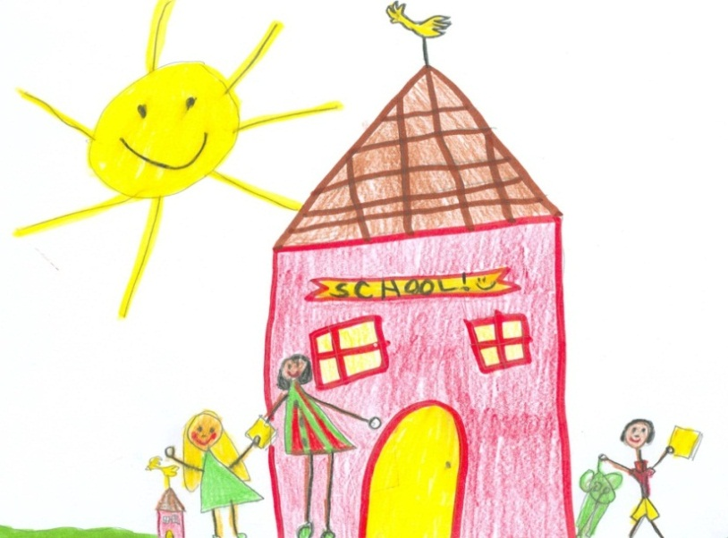

Listening Comprehension
Notes:
Introduce yourself and welcome participants.
Say: Let’s begin by reviewing the materials you need for this training.
(Hold items up as you talk.)
Say: You have 2 sets of handouts. You should have 1 set that says PowerPoint Presentation, and one that says Additional Handouts.
We’ve also provided you with a pink Big Ideas Card and a blue lesson planning card.
Now that we have all of our materials ready, let’s begin our session.

Slide 2
Read Aloud Everyday
Share Your Thinking
Make it Interactive
Build Vocabulary
Notes:
Say: We will use this card today to help us track the important information we should take away from this session.
Click for first bullet to appear.
Say: On the first line, I would like you to write, “Read aloud everyday.”
Say: Listening comprehension has a positive effect on student’s story recall, word identification, and phonemic awareness. During daily read-alouds, we are laying the foundation for our students to be successful with reading comprehension.
Click for second bullet to appear.
Say: On the second line, I would like you to write, “ Share your thinking.”
Say: We want to teach our students the many thinking processes that proficient readers use automatically. We explicitly model the strategies we use for understanding text, making it visible to our students, by sharing our own thinking.
Click for third bullet to appear.
Say: On the next line, I would like you to write, “Make it interactive.”
Say: Invite students to join in with the story by repeating phrases, making hand gestures or engaging in conversation. Allowing students to become a part of the read-aloud helps to extend their thinking and comprehension.
Say: During the read-aloud, teach critical vocabulary words right at the point of use. This is done with minimal interruption with the flow of the story. We can teach key vocabulary words with actions as well as verbal definitions.
Click for last bullet to appear.
Say: On the last line, write “Build vocabulary.”

Slide 3
Goals for This Training:
  Clarify the importance of listening comprehension.
  Describe a quality listening comprehension program.
  Reflect on lesson planning.
  Plan and practice a first reading.
Notes:
Say: Today, we will:
Clarify the importance of listening comprehension
Describe a quality listening comprehension program
Reflect on lesson planning, and
Plan and practice a strategy instruction lesson.
Say: Let’s get started.

Slide 4
Listening Comprehension?
Why should we focus on
Notes:
Say: Why should we focus on Listening Comprehension? How will this help our students?

Slide 5
Why Focus on Listening Comprehension?
  Reading aloud helps students to:
  realize that reading is pleasurable
  make connections between words and how they sound
  learn concepts about print
  expand vocabulary
  learn about people, places, and things they haven’t experienced firsthand
  understand the reading process
  hear what smooth, phrased reading sounds like
  develop an understanding of various text structures
  learn comprehension strategies that good readers use
  (Snow, Burns, Griffin,1998; Duke & Pearson, 2002; Dougherty Stahl, 2004; Coyne, Kame’enui, Carnine, 2007)
Notes:
Say: When we read aloud to students we can expect the following…
Read Slide

Slide 6
Why Focus on Listening Comprehension?
  Students in classrooms where instruction concentrated on listening comprehension showed considerable growth in:
    Listening Comprehension
    Story Recall
    Word Identification
    PA
  The most significant gains were made by ELL students in the LC group
  (Solari, 2007)
Notes:
Say: We also know that when we read aloud to students and focus on listening comprehension it effects the literacy development of young students. For example, Dr. Emily Solari conducted a small study and found the following effects on literacy skills when intervention instruction concentrated on listening comprehension in kindergarten:
Read slide.

Slide 7

Why Focus on Listening Comprehension?
  Studies show that there is a strong relationship between listening and reading comprehension.
  (Aarnoust, van den Bos, & Brand-Gruwel, 1998; Garner, & Bochna 2004; Tabors, Snow & Dickinson, 2001)
Notes:
Read slide.
Say: In fact, development in listening comprehension may be one of the best predictors for reading comprehension in fourth grade. It is our responsibility to ensure that we have provided a strong foundation for comprehension from the time our students first enter school. We know that students who tend to struggle even from a young age, tend to struggle all though school.

Slide 8
Why Focus on Listening Comprehension?
The poor first-grade reader almost invariably continues to be a poor reader.
(Francis, Shaywitz, Stuebing, Shaywitz, & Fletcher, 1996; Torgesen & Burgess, 1998)
74% of children who are poor readers in 3rd grade will remain poor readers in 9th grade. (Francis, D., Shaywitz, S., and Fletcher, J. 1996)
Notes:
Read slide.
We can conclude from this research that focusing on listening comprehension is critical for our students, and that we must make time for this instruction daily in our whole group and small group instruction. Strong instruction in all five components helps to ensure that students will be successful in all aspects of reading.

Slide 9

Why Focus on Listening Comprehension?
Figure 19 - Reading/Comprehension Skills
Kindergarten - The student is expected to:
discuss the purposes for reading and listening to various texts (e.g., to become involved in real and imagined events, settings, actions, and to enjoy language);
Notes:
Say: In Texas, we are mandated to teach identified essential knowledge and skills. There are MANY TEKS that relate to listening comprehension. On this slide, we have included an example from Figure 19.
Read slide.
Say: It is important that we teach our students to use a variety of strategies to comprehend selections read aloud. Let’s consider what makes a good read aloud and how we can improve students listening comprehension.

Slide 10
An Effective read-aloud?
What are the Various Aspects of
Notes:
Say: Now I’m going to ask you to put yourself into the role of a student. For us to understand how we need to teach students, it may be helpful to think about how we, ourselves, learn, and process information. As teachers, we need to be metacognitive—aware of our own thinking and what keeps us engaged in listening to a story and comprehending well.
To reinforce this idea, I am going to read you a story. Your job will be to think about all that goes through your mind and what makes this read-aloud effective. For example, what keeps you interested and engaged? What do I do to help you to understand the story better? If you like, you may jot down these ideas on a sticky note.

Slide 11
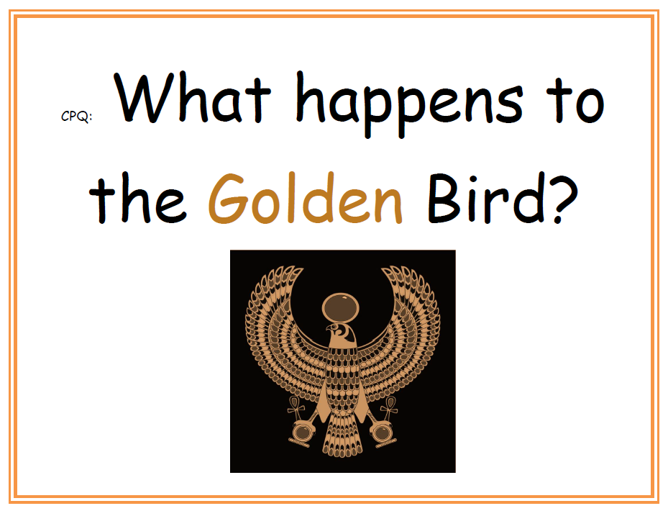
Notes:
Demonstration read-aloud: The Golden Bird of Freedom. You will need a copy of the story to read from. It is important to practice reading this story aloud prior to the demonstration.
Say: Today, boys and girls, I am going to read you a story called The Golden Bird of Freedom.
While you are listening to the story, I want you to think about this question: “What happens to the Golden Bird?” So remember, as you listen to the story think about what happens to the Golden Bird.
Move to Presenter mode and say: Since you are not really my students, your CPQ is to think about what are the various aspects of an effective read-aloud? Now, back in teacher mode as I model what would happen in my classroom.
Follow the script in the story handout.

Slide 12

What are the Various Aspects of an Effective Read Aloud?
Think Turn Talk
Notes:
Presenter Mode Say: I would post this question so that all of my students could see it. This is a good question as it will focus student attention throughout the story, and because many things happen to the Golden Bird. This question will help facilitate recall of the stories events and will aid in retelling, an important comprehension aspects we want our students to learn.
Say: What did you notice from my demonstration? What are the various aspects of an effective read-aloud?
Model the hand signals for Think-Turn-Talk. Provide 1 – 2 minutes Think-Turn-Talk time.
Share out whole group. Use popsicle sticks to solicit answers from the participants. Reinforce, prompt, and probe to encourage the group to share a variety of responses. (2 – 3 min.)
Note to Presenter:
Participants might identify the following.
The demonstration included: a participatory response, a CPQ, Think-Turn-Talk, a teacher think-aloud of using reading strategies, use of expressive voice, vocabulary definitions woven into the story reading, the selection of an appropriate story, use of facial expressions and hand gestures, being well-planned, etc.
When a participant identifies one of the listed aspects, reinforce their answer by explaining why that aspect is important to include in an effective read-aloud. For example, when a participant suggests that the story was told enthusiastically (prosodically), take the opportunity to reinforce that, when reading stories to children, we should read with a voice that makes them interesting and easy to listen to.

Slide 13
listening comprehension PROGRAM?
How do we ensure a quality
Notes:
Say: Now that we’ve experienced an effective read-aloud, let’s think about what we need to do to ensure that a quality listening comprehension program is implemented in our classrooms.

Slide 14
Read Aloud Everyday
The best way to ensure a quality listening comprehension program is to read aloud to students daily. This can be done with our core program as part of our reading block. It can also be accomplished outside of reading and/or as part of other content areas such as math, science and social studies.
Notes:
Read slide.

Slide 15
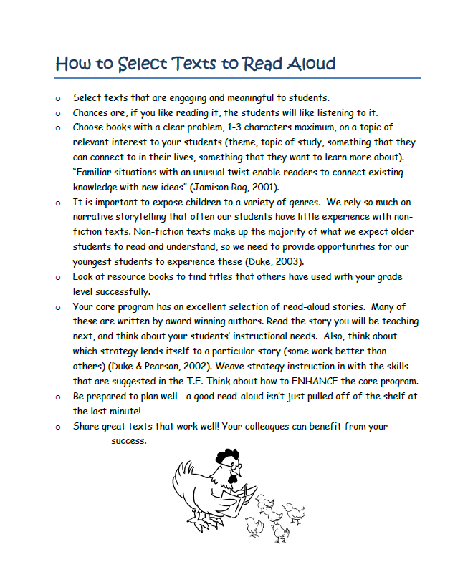
Select Appropriate Texts to Read Aloud
Read Handout #1
CPQ: What’s important to keep in mind when selecting texts to read aloud?
Notes:
Read slide.
Say: After you finished reading, please share your thinking with a partner.
Provide time for participants to read and discuss.

Slide 16
Plan in Advance
Plan what you will do in the first, second and/or third reading of the book.
Plan what you will do before, during and after reading.
Plan a “great” Comprehension Purpose Question (CPQ).
Notes:
Say: The key to success in teaching comprehension, listening or reading, is being well planned. After you have selected a quality text, then you need to take time to plan.
Read first bullet.
Say: Rereading QUALITY text is essential. Rereading reinforces children’s knowledge of the reading process. Comprehension improves with every reading, and students will gain a deeper understanding of the text. Rereading also provides opportunities for students to strengthen vocabulary.
Read second bullet.
Say: We need to make decisions regarding what is most critical to include in all parts of the lesson. Before reading we spend 3-4 minutes of our total lesson time preparing students for the reading. We think about what we might need to do to activate or build background knowledge. We think about how we will scaffold for difficult vocabulary. The during reading part of the lesson should be where you spend the majority of your time because you will model and reinforce the comprehension strategy you are teaching. After reading should also be a small part of the lesson, taking only about 5 minutes.
Read last bullet.

Slide 17
Plan a “Great” Comprehension Purpose Question (CPQ)
Thoughtful “questions appear to be effective for improving learning from reading because they:
give students a purpose for listening/reading;
focus students’ attention on what they are to learn;
help students to think actively as they read;
encourage students to monitor their comprehension; and
help students to review content and relate what they have learned to what they already know.”
(CIERA, 2003)
Notes:
Say: Research tells us that this type of thoughtful teacher questioning benefits comprehension in many ways.
Thoughtful “questions appear to be effective for improving learning from reading because they:
Read slide.
Say: In planning our CPQs, we think about how many times we’ve read a story. Some texts we will read only once, some we read many times. If it’s the first reading, we’ll set a general question. The story’s title, chapter headings, and subheadings within the text may help us set such a question. For subsequent readings, we set different CPQs each time we read. We have only one CPQ for students to focus on at a time.
We try to link the CPQ to the strategy focus for the lesson. For example, if we’re focusing on making connections, then set a CPQ that will guide students to understand the character or situation better through the connections that they make.
We post the CPQ for all to see. For younger students, we use pictures or colored text to support their understanding.
ALWAYS, we discuss the CPQ at the end of the reading. The purpose for setting CPQs is to guide students’ thinking so that they deepen and extend their understanding, and we must be sure that they are on the right track.

Slide 18
Effective Read-Alouds Are Interactive
When students have opportunities to
respond DURING the read-aloud, the
greatest quality and quantity of discussion
occurs.
(Sipe, 1998)
These dialogic read-alouds “result in gains in vocabulary, comprehension strategies, story schema, and concept development.”
(McGee & Schickedanz, 2007)
Notes:
Say: Effective read-alouds are interactive. During the reading, engage students with a participatory role in the story.
Read the first bullet on the slide.
Say: It is during reading that we need to provide time for students to Think-Turn-Talk. Sipe goes on to tell us that it is during this time that our students construct understanding, clarify confusions, and ask questions. We can scaffold students’ understanding as it is in the process of being constructed (Sipe, 1998).
Read the second bullet on the slide.
Say: Talking DURING reading has a powerful effect, but only if the talk is focused. Whitehurst & Lonigan (2001) tell us that teachers may prompt children to engage in the type of thinking and discussion that will enhance comprehension by asking thoughtful questions, making comments, and thinking aloud. Jamison Rog (2001) remind us that it is important to plan in advance where and how often to stop for discussion, so that we are not disrupting the flow of the reading too much. There is a delicate balance that must be found. It is this type of purposeful instruction that extends students’ thinking and their knowledge of the reading process.
In order for our read-alouds to be effective, we need to plan in advance how listeners will engage in the read-aloud.

Slide 19
Effective Read-Alouds Are Interactive
Plan stops and prompts well in advance.
Where will you stop?
Why will you stop there?
  What is the critical information?
  Is there a part that students will need support in understanding?
  How long have students been sitting and listening?
Notes:
Say: It’s critical that Think-Turn-Talk be planned well in advance. In thinking about a specific text ask: Where will you stop to ask questions? Why will you stop there? What question prompt will you use?
We might look for a spot that has critical information we don’t want our students to miss; we might think about which parts could be confusing to our students; and we think about how long they have had to sit and listen.

Slide 20
Effective Read-Alouds Are Interactive
Ask questions that involve critical thinking, opinion, or an extended answer.
General: “What are you thinking?”
Specific: “Why does the character …?”
Ask questions that relate to the CPQ
Ask questions that reinforce the cognitive strategy you are focusing on in the lesson
Notes:
Say: Question prompts are used to engage students in discussion for Think-Turn-Talk. You might just use a generic question such as, “What are you thinking now?” You may also choose to use questions that are more specific to a particular text, such as asking what motivates a character’s actions.
In choosing questions, you may refer back to the Comprehension Purpose Question (CPQ) so that students can reflect on the CPQ and continue to gather information that will help them to answer the CPQ.
When possible , we also try to connect Think-Turn-Talk to the comprehension strategy we are studying.

Slide 21
Effective Read-Alouds Are Interactive
After a student shares what s/he thinks, ask, “What makes you think that?”
Follow-up student sharing with immediate and corrective feedback.
metacognition
Notes:
Say: Whatever the question we choose, it should be one that allows our students to express their thinking. Questions that have only one correct answer, or where the answers can be found “right there” in the text, do not prove as effective for use with the Think-Turn-Talk routine.
Read first bullet.
Click to reveal text: metacognition.
Say: Researcher Janet Wilde (1998) says, “Teachers can encourage children to make their understanding explicit by talking about it. Research shows that students who talk about how they and others think become better learners.”
Because we have thought carefully about our questions, we do not want to forget them in our actual implementation of the lesson. If we write our Think-Turn-Talk question on a sticky note and place it on the page where we plan to use it, we have a good reminder to ourselves. Because student engagement is so important, we must make sure that we don’t forget our planned discussions.

Slide 22
Weave Vocabulary Instruction
Into the Lesson
Select 3-4 words or phrases from the book that you will define DURING the reading. These words should be critical to understanding the story and should be words that students will encounter again in future readings.
(Archer, 2008; Beck, McKeown & Kucan, 2002; McGee & Schickedanz, 2007)
Notes:
Say: Along with all the planning we’ve addressed thus far, we also want to be sure to plan how vocabulary instruction will occur in the read-aloud. One way is to weave the instruction into the story being read.
Read slide.
Say: Think back to The Golden Bird of Freedom. There were some challenging words in the story such as furious, annoy, and mark. Did I pre-teach those words to you before the lesson? Did it interrupt the flow of the story when I wove the explanations into the story? What about the word slung, when the hunter slung the sack over his shoulder? How did I clarify that word for you? (Acted it out, provided context)
Research on vocabulary instruction says this: “If the word is likely to affect comprehension of the story, then the most effective place to introduce word meaning may be at the moment the word is met in the text. The meaning can then be integrated into the context of use immediately, which provides strong support for comprehension” (Beck, McKeown, & Kucan, 2002).
The goal is to clarify difficult words to aid in understanding. “For words that are going to be clarified verbally, we plan short explanations that are “slipped” into the story reading so the definitions are part of the actual story without interrupting the flow of reading” (McGee & Schickedanz, 2007).

Slide 23
Rich Explanations of Vocabulary Words
  Point to the illustration
  Provide a definition using language that students understand
  Use a synonym
  Use a gesture or tone of voice
  Use the word in a new context
  Ask students to apply the word to a context they know
  (Archer, 2008; Beck, McKeown & Kucan, 2002; National Reading Panel Report, 2000)
Notes:
Say: The National Reading Panel (NRP) report explains that students need multiple, repeated exposures to vocabulary if we are to see learning gains. This extended, rich instruction of vocabulary should include some of the following practices:
Read slide.
Say: Directly weaving vocabulary instruction into our read-aloud as we’ve discussed is most helpful to students. Sometimes we can clarify vocabulary by changing the tone of our voice and reading expressively.

Slide 24
Read Expressively
“By reading aloud with expression, teachers model for students meaningful, fluent reading … it is the expressive reading by the teacher that makes read aloud so special. Students learn that, to have the same impact when they read aloud, they need to read with expression.”
(Rasinski, 2003)
Notes:
Say: When we take on the voice of a character, we are providing a scaffold for students to aid comprehension. When we read aloud to students, we can make the reading so much more engaging and enjoyable for the listener if we read expressively. When reading expressively, we are also modeling fluent reading for students.
Read slide.
Now that we have a clear understanding of what makes an effective Listening Comprehension program, we need to practice planning an effective first reading of a story.

Slide 25
How do we Ensure a Quality Listening Comprehension Program?
Think Turn Talk
Notes:
Read slide.
Provide time for participants to discuss.
Say: Now that we have a clear understanding of what makes an effective Listening Comprehension program, we need to practice planning an effective first reading of a story.

Slide 26
Effective first reading
Planning for an
Notes:
Read slide.

Slide 27
Planning for an Effective First Reading
  Build/Activate Background Knowledge
  Address difficult vocabulary
  Set an overarching, general CPQ
  Plan ways to engage students in the reading
    Participatory response, Think-Turn-Talk, using body, voice or gestures to make the reading interesting
Handout
#2
Notes:
Say: If our goal is to improve comprehension, then it is important to ensure that students are engaged in the reading. Let’s take a look at the lesson plan and think about how we planned to accomplish this.
Handout #2 is the lesson plan for The Golden Bird of Freedom. We’ve also provided you with a blank lesson plan format for an effective first reading lesson. Please follow along on Handout #2.
Read first bullet.
Say: We didn’t actually model this part of the lesson for you, but it is always important to include. Keep in mind, this should really only take a couple of minutes and doesn’t necessarily involve a picture walk. Building and activating background knowledge is addressed in-depth in the Making Connections training.
Read second bullet.
Say: Let’s consider the challenging vocabulary we wish to address during the read-aloud.
Read third bullet.
Say: Remember, when we set a comprehension purpose question, or CPQ, we do so for every reading. We want to choose a question that will focus attention throughout the reading. We set a different CPQ each time we read the text, and we link the CPQ to the strategy we are focusing on.
Read fourth bullet.

Slide 28
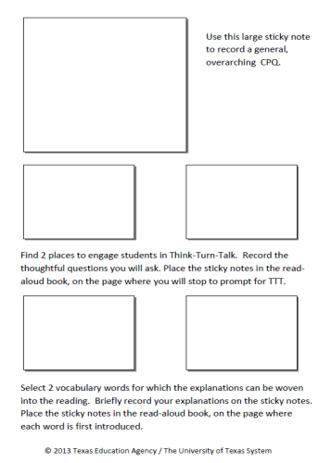
Your Turn
Select a read-aloud that you will use in the next week. Take time to think, plan, and practice an effective first reading of that text.
  On planning form for CPQ & TTT select:
      An overarching, general CPQ
      2 places for Think-Turn-Talk
      2 vocabulary words for which explanations
      can be woven into the reading
  2. In groups of 3, practice reading your story as if you were reading it to your students. Include voice inflections, facial expressions, and body movements to support comprehension.
Notes:
Read slide.
Distribute blue laminated planning cards with sticky notes. Provide 15 – 20 minutes for this activity.

Slide 29
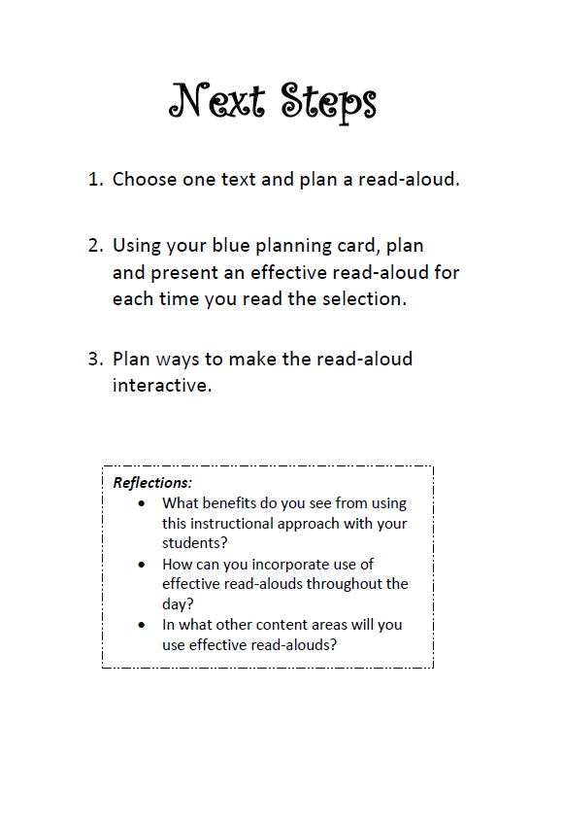
Notes:
Say: Let’s revisit the “big ideas” for this session.
First, listening comprehension has a positive effect on student’s story recall, word identification, and phonemic awareness. During daily read-alouds, we are laying the foundation for our students to be successful with reading comprehension.
We want to teach our students the many thinking processes that proficient readers use automatically. We explicitly model the strategies we use for understanding text, making it visible to our students, by sharing our own thinking.
Invite students to join in with the story by repeating phrases, making hand gestures or engaging in conversation. Allowing students to become a part of the read-aloud helps to extend their thinking and comprehension.
During the read-aloud, teach critical vocabulary words right at the point of use. This is done with minimal interruption with the flow of the story. We can teach key vocabulary words with actions as well as verbal definitions.
As you leave this session today, we want to think about our next steps. We want to take what we have learned here and apply it in our classrooms so that we can truly impact student learning and achievement. Read the 3 steps on the back of this card. Write down at the bottom what your commitment will be for teaching this strategy when you return to school.

Slide 30
“Every child begins school wanting to learn to read. In other words, we’ve got 100 percent enthusiasm and desire when they start school … but lose 78 percent of our potential lifetime readers by senior year. Any business that kept losing that much of its customer base would be in bankruptcy.”
(Trelease, 2006)

Slide 31
References
Aarnoust, C., van den Bos, K, & Brand-Gruwel, S. (1998). Effects of listening comprehension training on listening and reading. Journal of Special Education, 32, 115-126.
Archer, A. (2008, May). Dynamic vocabulary instruction. Presented at the Advanced Coaching Institute III Texas Reading First Conference, Houston , TX.
Beck, I., McKeown, M. & Kucan, L. (2002). Bringing words to life: Robust vocabulary instruction. New York, NY: The Guilford Press.
Center for the Improvement of Early Reading Achievement. (2003). Put reading first: The research building blocks for teaching children to read, kindergarten through grade 3. Jessup, MD: National Institute for Literacy at ED Pubs.
Coyne, M., Kame’enui, E. & Carnine, D. (2007). Effective teaching strategies that accommodate diverse learners, New Jersey: Pearson Education, Inc.
Dougherty Stahl, K. (2004). Proof, practice, and promise: Comprehension strategy instruction in the primary grades. The Reading Teacher, 57(7), 598-609.

Slide 32
References
Duke, N. (2003). Informational text? The research says, “Yes!” In L. Hoyt, M. Mooney & B. Parkes (Eds.), Exploring informational texts: From theory to practice. Portsmouth, NH: Heinemann.
Duke, N. K. & Pearson, P. D. (2002). Effective practices for developing reading comprehension. In A. E. Farstrup & S. J. Samuels (Eds.), What research has to say about reading instruction. Newark, DE: International Reading Association, Inc.
Francis, D., Shaywitz, S., Stuebing, K., Shaywitz, B., & Fletcher, J. (1996). Developmental lag versus deficit models of reading disability: A longitudinal, individual growth curves analysis. Journal of Educational Psychology, 88(1), 3-17.
Garner, J. & Bochna, C. (2004). Transfer of a listening comprehension strategy to independent reading in first-grade students. Early Childhood Education Journal, 32(2), 69-74.
Jamison Rog, L. (2001). Early Literacy Instruction in Kindergarten. Newark, DE: International Reading Association, Inc.
McGee, L. & Schickedanz, J. (2007). Repeated interactive read-alouds in preschool and kindergarten. The Reading Teacher, 60(8), 742-751.

Slide 33
References
National Reading Panel. (2000). Report of the National Reading Panel: Teaching Children to Read. Report of the Subgroups. Washington, D.C.: U.S. Department of Health and Human Services, National Institutes of Health.
Rasinski, T. V. (2003). The fluent reader: Oral reading strategies for building word recognition, fluency, and comprehension. New York: Scholastic Professional Books.
Sipe, L. (1998). First and second graders construct literary understanding during read-alouds of picture storybooks: Dissertation Award. The 20th yearbook: A peer-reviewed publication of the college reading association, 49-67.
Snow, C., Burns, M., & Griffin, P. (1998). Preventing reading difficulties in young children. Washington, DC: National Academy Press.
Solari, E. (2006). Effects of listening comprehension versus phonological awareness intervention. Santa Barbara: University of California.
Spalding, A. (1989). A world of stories: The golden bird of freedom. Red Deer, AB: Red Deer College Press.

Slide 34
References
Tabors, P., Snow, C. & Dickinson, D. (2001). Homes and schools together: Supporting language and literacy development. In D. Dickinson & P. Tabors (Eds.). Beginning literacy with language: Young children learning at home and school. Baltimore, MD: Paul H. Brookes Publishing.
Torgesen, J. & Burgess, S. (1998). Consistency of reading-related phonological processes throughout early childhood: Evidence from longitudinal-correlational and instructional studies. In J. Metsala & L. Ehri (Eds.), Word recognition in beginning literacy. Mahwah, NJ: Lawrence Erlbaum Associates Publishers.
Trelease, J.(2006). The read-aloud handbook. NY: Penguin Group (USA) Inc.
Whitehurst, G. & Lonigan, C. (2001). Emergent literacy: Development from prereaders to readers. In S. B. Neuman & D. K. Dickinson (Eds.), Handbook of early literacy research. New York, NY: The Guilford Press.

