Slide 1


Cognitive Strategy Routine
Kindergarten – Grade 2
Notes:
Introduce self and welcome participants.
Let’s begin by reviewing the materials you need for this training.
(Hold items up as you talk.)
Say: You will have two sets of handouts. You will have a PowerPoint Presentation Handout and Additional Handouts. You will also need the blue and white Cognitive Strategy Routine card. As part of this training, you will also receive a poster set for all of the cognitive strategies. We won’t need the posters during the training, but you will each have a set for your classroom in both English and Spanish.

Slide 2

Big Ideas
Consistent routine
Eight steps
Six cognitive strategies
Notes:
Say: Before we begin this training, let me share with you three Big Ideas that I would like you to take away from this session.
As I talk about these ideas, take a moment to write them down on your PowerPoint Presentation handout. This will help you to stay focused on the key information throughout this training.
Click for first bullet to appear (Consistent routine).
Say: The routine we will introduce today is a routine which can and should be used when teaching any of the six comprehension strategies, including Creating Mental Images, Making Connections, Making Inferences & Predictions, Determining Importance & Summarizing, Asking & Answering Questions, and Monitoring& Clarifying. The same routine is designed to be used at every grade level as well as in both English-language and Spanish-language instruction. The consistency of the routine will help ensure that students receive the same strategy instruction, using the same academic language, across school years. This will help eliminate the confusion that occurs when students are taught one strategy or academic term at a lower grade level, but a new strategy or new name is given to the same instruction at another level.
Click for second bullet to appear (Eight steps).
Say: The Cognitive Strategy Routine has eight steps which are used when introducing or reinforcing any of the six comprehension strategies. We will learn those eight steps today.
Click for third bullet to appear (Six cognitive strategies).
Say: As I already mentioned, there are six cognitive comprehension strategies which a good reader uses. Although we teach each strategy distinct from the others as they are introduced, we also give students opportunity to master each of the six strategies, and we model the way in which all of the strategies are used together as needed when a good reader reads. The goal is for each student to have mastery of all of the strategies so that they can use them automatically and interchangeably as needed to comprehend text.
We will explain and demonstrate for you a consistent, explicit eight-step routine for use with all students when teaching and reinforcing each of the six comprehension strategies.

Slide 3
Goals for this Training
Reflect on the importance of comprehension instruction
Discuss the cognitive strategies good readers use to comprehend
Introduce a routine for explicit instruction of these cognitive strategies
3
Notes:
Say: Let’s consider our goals for this training.
Read first two bullets.
Say: We will complete an activity today to guide us to be aware of the cognitive strategies we use to comprehend.
Read third bullet.
Say: The strategies that each of us use to comprehend while reading are the same cognitive strategies that we will explicitly teach our students. Instruction in comprehension should occur every day. During this P.D. we will explore a routine, outlined as a specific series of steps, that we can use to enhance our comprehension instruction.

Slide 4
Comprehension?
Why Should we Teach
Notes:
Say: So now let’s take a look at some reasons which support the systematic, explicit instruction of comprehension strategies.

Slide 5

Why Should we Teach Comprehension?
Think about your data.
  What does your data indicate regarding student comprehension?
5
Notes:
Read slide. Encourage participants to popcorn out their thoughts.
Say: Regardless, of what data we look at, TPRI, Tejas LEE, iStation, or DIBELS, we likely can agree that we would desire that all of our students be developed and experiencing success in the areas of listening and reading comprehension. In fact, we likely feel a sense of urgency in helping students to improve their comprehension. We know that as text becomes more and more complex, it becomes more difficult to comprehend. It is critical that our students have specific strategies and routines to support their comprehension.
Today, we will examine a specific eight-step routine that can be used across grade levels to support and increase comprehension for our students.

Slide 6
Durkin, 1978-79; RAND, 2000; Taylor, Pearson, Clark & Walpole, 1999; Taylor, Peterson, Pearson & Rodriguez, 2002
6
Notes:
Say: We have discussed the urgency of continuing a focus on comprehension instruction. This focus will require time. Yet research shows that, often, time is one of our challenges.
Let’s look at this graph. What does this information tell us? (Pause)
In the late 1970s, research by Delores Durkin revealed that of the 4,469 minutes of reading instruction she and her colleagues observed, only 28 minutes — less than 1% instructional time — was dedicated to comprehension instruction (Durkin, 1978-79). Keep in mind that other comprehension activities might have been taking place, such as asking students assessment questions, but that would not be considered instruction.
More recent research studies suggest that not much has changed; explicit comprehension instruction is still not adequate.
(RAND Reading Study Group, 2002; Taylor, Pearson, Clark & Walpole, 1999; Taylor, Peterson, Pearson & Rodriguez, 2002).

Slide 7
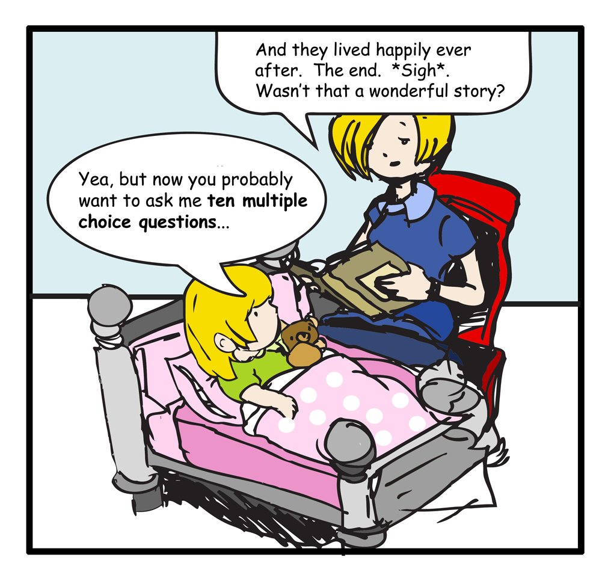
Cartoon by Bang Pham, 2008
7
Notes:
Read cartoon.
Say: Why is this cartoon funny?
Ask a participant to explain.
Say: Right, this little girl is so used to answering questions after reading that it has become an expectation for her. Historically this is how we’ve taught comprehension. Students read or listen to an assigned piece, and we ask questions at the end to assess how well they comprehend. We may even follow up this task by placing a number in our grade books.
Without direct, explicit, systematic comprehension instruction, this picture will not change. High quality instruction has the most potential for changing student outcomes (Durkin, 1978-79; NRP, 2000 as cited in VGCRLA, 2008).

Slide 8

Why Teach Cognitive Strategy Routine?
Improving comprehension instruction for ELLs includes:
Instructional routines.
Explicit and direct explanations of strategies.
Modeling and think-alouds.
Teaching useful linguistics structures.
Providing high levels of support by scaffolding learning before, during, and after reading.
Providing opportunities for structured practice.
(Francis, Rivera, Lesaux, Kieffer, & Rivera, 2006; Dresler 7 Kamil, 2006; Genesee, Geva, Dressler, & Kamil, 2006; Lesaux, Lipka, & Siegle, 2006; Roit, 2006.)
Notes:
Say: Reading comprehension is also an area of difficulty for English Language Learners. We can help ELLs learn strategies that enable them to comprehend what they read.
Read slide.

Slide 9
Why Teach Cognitive Strategy Routine?
Improving comprehension instruction for ELLs includes:
Actively engaging students in monitoring, carefully selecting strategies, and reflecting on use of strategies.
Helping students to understand how to adjust for the type of text being read, the purpose for the reading, and the format of the content.
Alignment of comprehension instruction across the curriculum so students have opportunities to transfer and adapt strategies to new contexts.
(Francis, Rivera, Lesaux, Kieffer, & Rivera, 2006; Dresler 7 Kamil, 2006; Genesee, Geva, Dressler, & Kamil, 2006; Lesaux, Lipka, & Siegle, 2006; Roit, 2006.)
Notes:
Read slide.

Slide 10
“Good comprehension instruction includes both explicit instruction in specific comprehension strategies and a great deal of time and opportunity for actual reading, writing, and discussion of text” (Duke & Pearson, 2002, p. 207).
10
Notes:
Say: What should good comprehension instruction include?
Read slide.
Say: Reread this quotation and highlight two or three words that really stand out to you. When you’ve finished, share the words you highlighted with a partner, and tell them why you thought they were important.
Give participants one or two minutes to complete.
Say: These are the words that stood out for me.
Say: Our instruction must be explicit.
Click to highlight the word explicit.
Say: We teach the specific comprehension strategies that research has shown to be used by proficient readers.
Click to highlight the word specific.
Say: And our instruction must allow our students the opportunity to apply what they’ve learned through their own reading, writing, and discussion.
Click to highlight the word opportunity.

Slide 11
What cognitive strategies do Proficient readers use?
Notes:
Say: Consider: What cognitive strategies do proficient readers use?

Slide 12


Cognitive Strategies
Making Inferences & Predictions
Determining Importance & Summarizing
Monitoring & Clarifying
Making Connections
Asking & Answering Questions
Creating Mental Images
12
Notes:
Say: Here are the cognitive strategies that we just discussed. You will notice that we have highlighted 6 thinking processes that proficient readers use. “…[E]ffective readers actually use a small repertoire of strategies…. For students to acquire such skills to the point of internalization probably requires several years of instruction and scaffolded use, although comprehension gains should be quite pronounced even during the first year (Brown et al., 1996; Pressley et al., 1992). Yes, we have a vision of what it takes to create strategic elementary readers” (Pressley, April 2006, p. 18).

Slide 13
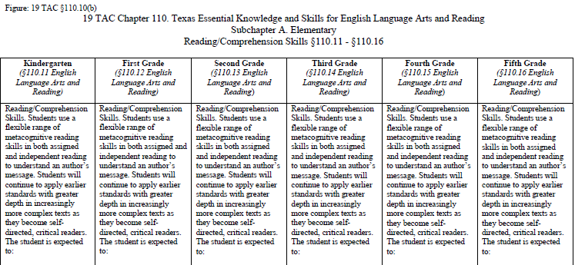
Framework for Instruction to
Teach the ELAR/SLAR TEKS
Handout #1
Cognitive Strategy Routine
13
Notes:
Say: As we reflect upon our own strategy use, we can see how important it is to ensure that our instruction focuses on ALL of the cognitive strategies that proficient readers use. Our ELAR and SLAR TEKS reinforce this notion as it outlines student expectations in the area of comprehension.
This is Figure 19. It is part of the comprehension ELAR/SLAR TEKS.
Let’s focus on the student expectations for kindergarten through second grade as a way to frame our discussion.
CLICK for arrow to appear.
Say: Students use a flexible range of metacognitive skills. We introduce our students to the various strategies through direct, explicit, systematic instruction following the cognitive strategy routine.

Slide 14
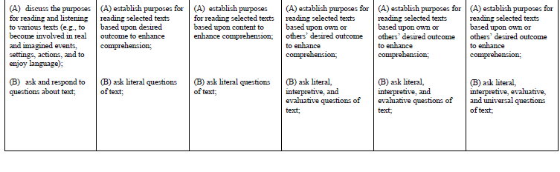
Reading With Purpose (CPQ)
Asking Questions
14
Notes:
Say: Student expectation A
CLICK for first arrow to appear.
Say: …establish purposes for reading selected texts is addressed in our Reading With Purpose module.
Student expectation B…
CLICK for second arrow to appear.
Say: …ask literal, interpretive, and evaluative questions of text is addressed in our Asking & Answering Questions module.

Slide 15
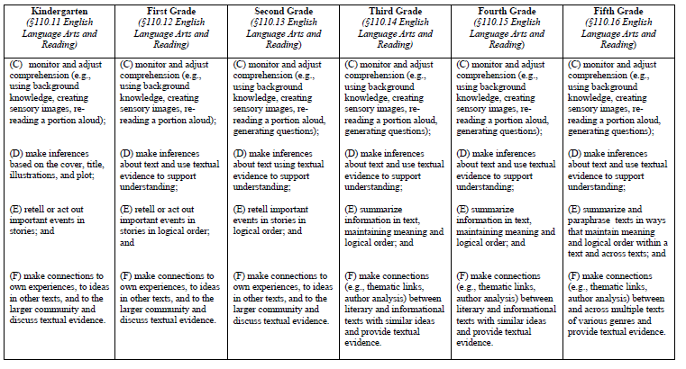
Making Connections
Creating Mental Images
Asking Questions
Making Inferences
Determining Importance
Making Connections
15
Notes:
Say: Student expectation C…
CLICK for arrow to appear.
Say: …explains that students are expected to monitor and adjust comprehension by using background knowledge
Which is addressed in the Making Connections module…
CLICK for arrow to appear.
Say: creating sensory images …
CLICK for arrow to appear.
Say: … rereading a portion aloud and generating questions. Student expectation D
CLICK for arrow to appear.
Say: …make inferences is addressed in our Making Inferences module. And E,
CLICK for arrow to appear.
Say: …students are expected to summarize information in text is addressed in our Determining Importance & Summarizing module.
And finally, student expectation F
CLICK for arrow to appear.
Say: …make connections
As you can see, the Elements of Understanding modules support the new TEKS very well. These module help to ensure high levels of quality instruction of the TEKS, which of course, directly impacts student achievement.
Let us now look at a routine for teaching each of these cognitive strategies effectively.

Slide 16
A Cognitive strategy routine
Notes:
Say: We’ve mentioned strategies several times. How will we teach them to our students?
As with much of what we teach, cognitive strategy instruction can be embedded within a routine. A routine is a set of clear, systematic steps that we use each time we introduce or focus on a strategy in our instruction. This routine guides us to ensure that our instruction is effective and explicit.

Slide 17
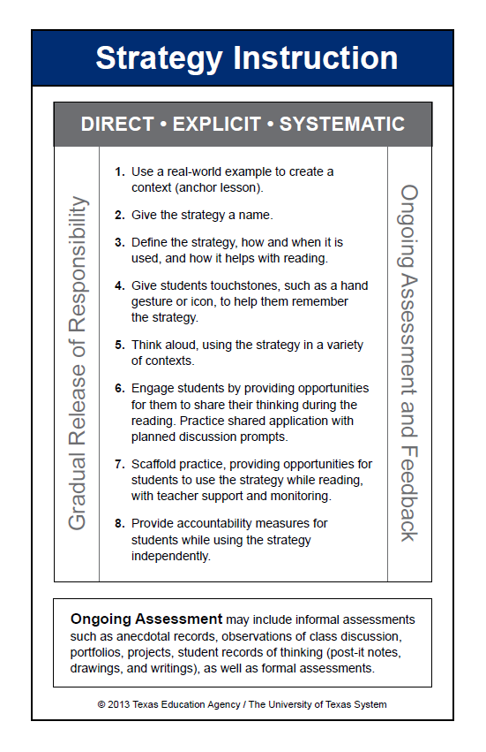
Notes:
Say: During the remainder of the presentation, we will be referring to this blue-and-white card. This is the Cognitive Strategy Routine card. Please take this card out now so that you can follow along.

Slide 18
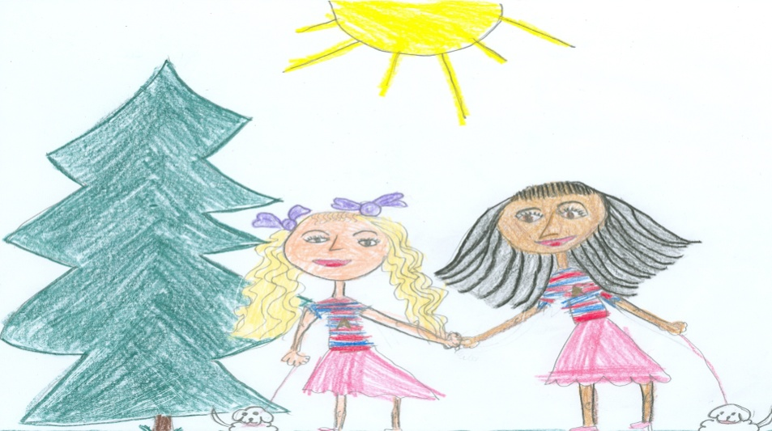
Making Connections
Kindergarten – Grade 2
Notes:
Introduce self and welcome participants.
Let’s begin by reviewing the materials you need for this training.
(Hold items up as you talk.)
Say: You will have two sets of handouts. You will have a PowerPoint Presentation Handout and Additional Handouts. You will also need the blue and white Cognitive Strategy Routine card, the orange Cognitive Strategy Lesson Planning card and your copy of Frog and Toad or Sapo y Sepo.

Slide 19
Big Ideas
Activate/build background knowledge
Making Connections = foundational strategy
Beware of distracting connections
Notes:
Say: Before we begin this training, let me share with you three Big Ideas that I would like you to take away from this session.
As I talk about these ideas, take a moment to write them down on your PowerPoint Presentation handout. This will help you to stay focused on the key information throughout this training.
Click for first bullet to appear (Activate/build background knowledge).
Good readers access their background knowledge when reading. As teachers, we can introduce text to students in a way that helps to activate readers’ background knowledge to aid comprehension. Sometimes however, our students may not have sufficient background knowledge about a subject. If this is the case, then we’ll need to help students to build background knowledge.
Click for second bullet to appear (Making connections=foundational strategy).
Say: Good readers make connections between text and their background knowledge to help them understand and remember the text better. Readers also use this background knowledge to create mental images, to make inferences, to ask questions, etc. Making Connections is really a foundational strategy because a reader needs to use background knowledge when applying the other strategies.
Click for third bullet to appear (Beware of distracting connections).
Say: Good readers also understand when their connections distract them and take them away from understanding the text. Distracting connections are quite typical with younger students. We’ll talk later in the session about how to manage distracting connections.

Slide 20
Training Goals
Clarify the difference between activating and building background knowledge.
Understand the importance of Making Connections as a foundational strategy.
Plan and practice an introduction lesson for Making Connections.
Plan and practice a think-aloud lesson for teaching Making Connections
Notes:
Say: Let’s review our goals for today.
Read slide.
20

Slide 21
What does this store sell?
Blinds For Sale
Goose Hunting Season Opens Soon
(Adapted from Wilhelm, 2004)
Notes:
Say: Let’s begin our session today by thinking about how we use our background knowledge to make connections and how this impacts our understanding. If you saw this sign, what kind of store do you think it would be? Turn and tell your partner.
Allow a moment for participants to talk with a partner. Have one or two participants share.
Say: Does this change your understanding?
Click to reveal text: Goose Hunting Season Opens Soon.
Say: Now what type of store do you think this might be?
Allow a moment for conversation.
Say: When we first read the sign, we used our background knowledge and made one connection. What did you connect to?
Click to reveal picture of window blinds.
Say: You probably thought of window blinds.
Click to reveal picture of camouflaged man.
Say: As we were provided with more information, however, we made another connection. We thought of another kind of blind – a place to camouflage while hunting. If you don’t have ANY background knowledge of a hunting blind, you might have become totally confused. Readers continually make connections to their background knowledge to help them understand text.

Slide 22
Why is Background Knowledge Important?
“The many active processes of reading –
prediction
construction of images during reading
monitoring of comprehension and rereading
summarization
interpretation
– depend greatly on prior knowledge.”
                (Pressley, 2000)
Notes:
Say: Our students must understand that what they already know is important. Therefore, we introduce them to the concept of background knowledge. Our background knowledge provides a basis for our use of most other cognitive strategies.
For example, when we create mental images, they are based on things we have seen and experienced – our background knowledge.
When we make inferences, we combine our background knowledge with information from the text. We use not only our background knowledge of “real-world” experiences, but our background knowledge of familiar text structures.
When something we read doesn’t fit in with our background knowledge, we ask questions to try to incorporate new learning into what we already know.
Therefore, Making Connections to background knowledge is often the first cognitive strategy we teach. As educational psychologist, Michael Pressley (2000) puts it:
Read slide.

Slide 23

“Our prior experience and background knowledge fuel the connections we make.
  the books we read
  the authors we choose
  the discussions we have
  our past experiences
  the newspaper
  the evening news
  the weekly magazines
  the Internet
  and nightly dinner table conversations …
  all forge connections that lead to new insight. We teach kids to think about their connections and read in ways that let them discover these threads.”
(Harvey and Goudvis, 2000)
Notes:
Say: In this quote, authors Stephanie Harvey and Anne Goudvis (2000) describes some of the ways we acquire background knowledge. Take a moment to read this slide and think about all the ways to build your background knowledge.

Slide 24


Knowledge of Baseball
Comprehension
Good Readers
Struggling Readers
(Recht & Leslie, 1988)
Comprehension
Notes:
Say: Let’s consider an example of how background knowledge makes a difference in comprehension:
Recht and Leslie (1988) conducted a study to research the effects of background knowledge on reading comprehension. They tested two groups of students – good readers and poor readers. They also tested the students’ knowledge of baseball.
Click to animate. There were good readers who had little knowledge of baseball.
Click to animate. There were good readers who knew a lot about baseball.
Click to animate. There were struggling readers who had little knowledge of baseball.
Click to animate. There were struggling readers who knew a lot about baseball.
Say: The students’ were then asked to read a passage about a baseball game and were tested on comprehension.
Click to animate. Struggling reader with baseball cap will rise to equal good readers.
Say: The researchers found that poor readers who knew more about baseball had comprehension almost equal to good readers who knew about baseball.
Click to animate. Good reader without baseball cap will sink to equal struggling reader. The good readers who didn’t know much about baseball struggled to comprehend the passage. Their comprehension wasn’t much higher than the struggling readers who didn’t know much about baseball.
In other words, we can better understand a text that’s about something familiar than we can a text that’s unfamiliar – even if we’re struggling readers.

Slide 25
All Students Have Background Knowledge
“…all students have background knowledge even though not all of them have the academic background knowledge necessary to do well in school. The background knowledge that is not germane to academic success may still be highly valuable in other contexts and, as such, should be honored along with the bearers of that knowledge.”
(Marzano, 2004)
Notes:
Say: Occasionally, we may hear a teacher say, “My students don’t have background knowledge.” ALL students, however, have background knowledge built on their life experiences. Some background knowledge is academic in nature and relates to things they will learn in school. A student who has been allowed to shop at the neighborhood store, for example, will have background knowledge for money and its uses. This knowledge will help the student during math lessons. A student who has never had such experiences may need to build the background knowledge from the ground up, and will find it more difficult.
Some background knowledge relates to non-academic concepts. For example, a student might have well-developed background knowledge about soccer. This may have some usefulness in school, but will be less-generally useful than background knowledge for using money.
We need to get to know our students well so that we can understand what they have developed background knowledge of. Once we have this knowledge, will need to do two things to make our comprehension instruction work: we will need to either build NEW background knowledge or activate EXISTING background knowledge.

Slide 26
Build? Or Activate?
Building Background Knowledge
Students know little or nothing about a topic
May take place 1-2 weeks before reading
Takes 3-4 exposures, no more than 2 days apart
Activating Background Knowledge
Students have some knowledge of a topic
Takes place directly prior to reading
Takes 2-10 minutes
Notes:
Say: What is the difference between building background knowledge and activating existing knowledge?
Click. Say: We build background knowledge when our students have little knowledge of the topic of a story.
Click. Say: When our students have some knowledge of a topic, and we simply want to help them remember, we activate background knowledge.
Click. Say: Building new background knowledge takes time. Therefore, we must plan ahead. We will begin one or two weeks before reading the selection.
Click. Say: Activating background knowledge can take place just a few moments before we read.
Click. Say: When building new background knowledge we must remember that a single exposure is not enough. It takes 3-4 exposures to new information, no more than two days apart.
Click. Say: Activating background knowledge should take only 2-10 minutes. We don’t want to tell our students everything that will be in the story – we must leave some problem-solving for them. Instead, we want to activate what is crucial to understanding.
Now we will look at each of these techniques separately.

Slide 27
Making Connections?
Why Should We Teach
Notes:
Say: Let’s begin by discussing why we should teach this strategy to students.

Slide 28
Why Teach Making Connections?
Connections help readers:
Relate to characters
Visualize
Avoid boredom
Pay attention
Listen to others
Read actively
Remember what they read
Ask questions
                (Tovani, 2000)
Notes:
Say: As discussed, accessing background knowledge increases our ability to retain new information (e.g. Recht and Leslie, 1988) and understand challenging text because it provides something for text information to “stick” to. New learning is incorporated into our background knowledge.
Now let’s think about how good readers use background knowledge to make connections while reading. Using background knowledge to make connections to the text helps enrich our understanding of the text.
Understanding more deeply impacts us in many ways. It gives us insight into the world and empathy for others, it creates within us a desire to read and re-read, and helps us to see how the world works (Keene, 2008).
We teach Making Connections because it helps us to bring enjoyment to reading.
Cris Tovani (2000) lists several ways Making Connections increases our interest and enjoyment in reading.
Read slide.

Slide 29
Making Connections?
How Do You Teach
Notes:
Say: We’ve looked at many reasons why it is important to teach the cognitive strategy Making Connections. Many of you teach this strategy to students, today however, we want to take about ways to make this instruction even more effective.

Slide 30
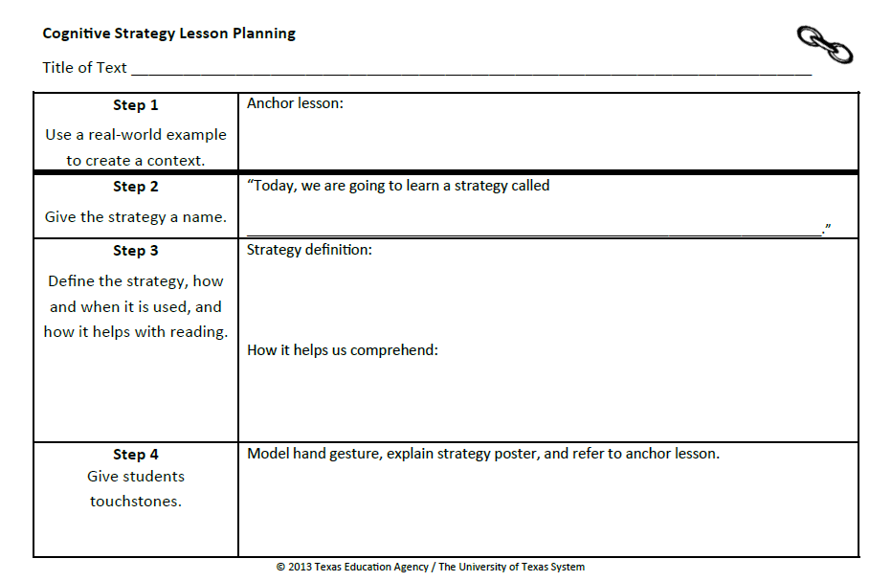
Introducing Cognitive Strategies
Notes:
Say: When we introduce a new cognitive strategy to our students, we must do so in a way that is direct, systematic and most of all, explicit. Students should understand what the strategy is and how it helps them understand. “… instruction should use modeling, thinking aloud, questioning, and other techniques to promote active construction of meaning” (Moats, 2005).
We have developed a routine to introduce and practice cognitive strategies. This routine is an 8 step process for directly and explicitly teaching strategies to students. Let’s review the steps now. Please take out your blue and white Cognitive Strategy Routine card and take a moment to read the 8 steps.
Allow participants one minute to review the steps on the card.
Say: You will also need the orange Cognitive Strategy Lesson Planning Card and a vis-à-vis for this part of the session.

Slide 31
Step 1: Anchor Lesson
“Today, we are going to explore our background knowledge. Did you know that everyone has background knowledge? Background knowledge is another way of saying, ‘What I know.’ You have lots of background knowledge because you know a lot about many things. We get background knowledge from doing things, seeing things, going places, from reading, and talking with others.”
Notes:
Say: As you recall, step 1 in our cognitive strategy routine is introducing the strategy with an anchor lesson. An anchor lesson is a simple stand-alone lesson that we can refer to when we discuss making connections in future lessons. This lesson should take approximately 20-30 minutes and should be done the day before you want to introduce the strategy with a piece of text. An anchor lesson does not typically involve text, it should be a memorable activity that demonstrates the strategy.
Read slide.

Slide 32

Notes:
Say: Look at this picture of a dog. I think that you all have some background knowledge about dogs. What do you know about dogs? Think for a moment (model hand signal). Turn and tell your partner everything you know about dogs (model hand signals).
Provide time for partners to talk. Select 3-4 people to share what they know about dogs. Record the information on a blank piece of chart paper as it is shared. Ask participants to explain why they know what they do about dogs. Reinforce that they know what they know because it’s part of their background knowledge.
Say: I noticed that some of you have lots of background knowledge about dogs perhaps because you have a dog. Some of you might not have ever had a dog, but you still know about dogs. Everyone has his or her own background knowledge. We use our background knowledge to make connections to new things we hear, see, or read. When we make connections, it helps us to understand and remember things. Background knowledge is like velcro in our brains. Connecting new information to what we already knows helps the new information stick in our brains.
Note to Presenter:
You might choose to model how a piece of Velcro works as you explain this to students.

Slide 33






My Background Knowledge
Handout #1
Notes:
Say: We all have background knowledge. What do you know a lot about? I know a lot about …
On the slide, add pictures of things you know about. Be prepared to explain why/how the things you show are part if your background knowledge.
Say: In class, I would invite my students to create their own background knowledge poster or to represent their background knowledge in some other way. For example, I might have students create a head shape (bust) out of clay. I would then have them write about what they know on thought clouds and have them tape the thought clouds to toothpicks so that they can stick them into their clay heads. As students share their work, you can reinforce both the uniqueness of their background knowledge and how their background knowledge connects to other students’ background knowledge.
This would be our anchor lesson for Making Connections. In the future, I could remind students, “Remember when we made our background knowledge posters, and you demonstrated some of the things you know a lot about? We use our background knowledge to make connections.”
This activity becomes an anchor that we can constantly refer to.

Slide 34
Step 1: Anchor Lesson
Use a real-world example to create a context.
Record what you will do for Step 1 on your orange Cognitive Strategy Lesson Planning Card.
Notes:
Say: Now it is your turn to think about Step 1. How will you introduce Making Connections to your students? Using a Vis-à-vis marker, please take a moment now to record on your orange Cognitive Strategy Lesson planning card what you will do for an anchor lesson. You might choose to do the same anchor lesson I modeled, or you might have a different idea of how to provide a real-world example to help your students understand the concept of Making Connections. Regardless, take a moment now to record what you will do for your anchor lesson in the space provided for Step 1.
Provide time for participants to compete Step 1 on their orange Cognitive Strategy Lesson planning card.

Slide 35
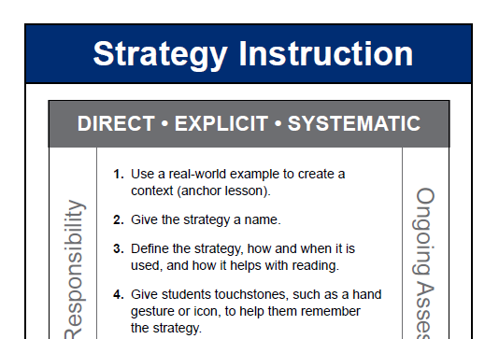
Teaching the Strategy (Steps 2-4)
Notes:
Say: An anchor lesson is our introduction to the strategy. Steps 2-7 are how we teach the strategy. These next three steps do not change. We will repeat what we plan to say and do for the next three steps EVERY time we teach this strategy. We do these three steps before every think-aloud or shared opportunity to use the strategy while reading.

Slide 36
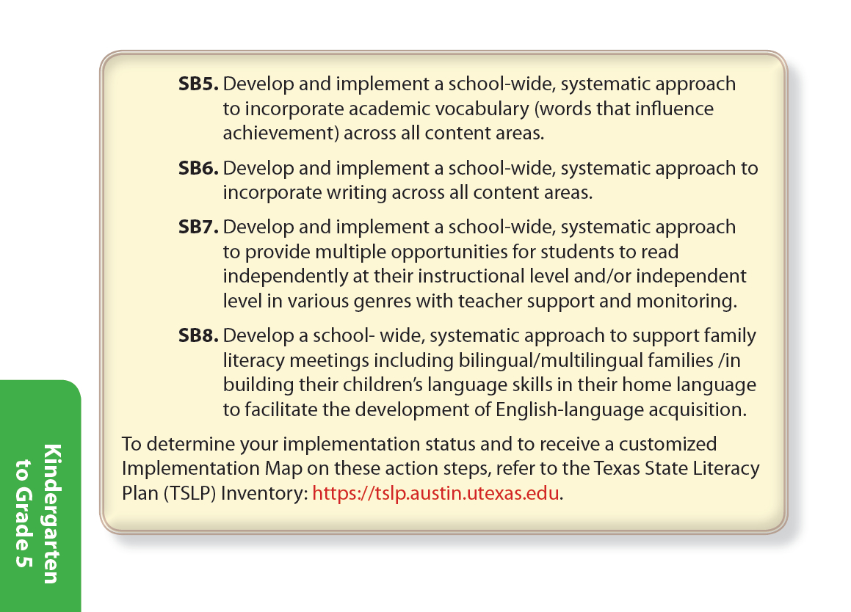

Step 2: Give the Strategy a Name
“Today we’re going to learn a strategy called Making Connections.”
Notes:
Say: Step 2 is, “Give the strategy a name.” We want to use clear and consistent language when referring to the cognitive strategies. Our comprehension strategy instruction is stronger if everyone in the school, from kindergarten to twelfth grade, uses the same vocabulary to refer to the strategies we are teaching. In fact, developing a common academic vocabulary is so important, that it’s even listed as an Action Step in Standards-based Instruction in the TSLP.
SB5: Develop and implement a school-wide, systematic approach to incorporate academic vocabulary (words that influence achievement) across all content areas.

Slide 37
Step 2: Give the Strategy a Name
“Today we’re going to learn a strategy called Making Connections.”
Record what you will say for Step 2 on your orange Cognitive Strategy Lesson Planning Card.
Notes:
Read red text and the bottom part of the slide.
Provide time for participants to compete Step 2 on their orange Cognitive Strategy Lesson planning card.

Slide 38
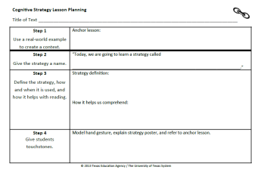
Step 3: Tell Why and How it is Used
Strategy Definition:
“We are going to learn how to use our background knowledge to help us understand what we are reading. When something in the text reminds us of something we know, we call that making a connection.”
How it helps us understand:
“When we make connections while reading, it helps us understand and remember the text better.”
Notes:
Say: Step 3, is where we tell why and how the strategy is used. This type of explicit instruction is critically important. When teachers explain concepts and skills through concrete, visible examples; provide clear, consistent routines; and maintain high expectations that are communicated to students, levels of both teaching and learning increase (Vaughn Gross Center for Reading and Language Arts, 2012).
To explicitly explain Making Connections to my students, I might say something like this, “Yesterday we explored background knowledge. We discovered that you each know a lot about many things and have lots of background knowledge. Today, we are going to learn how to use our background knowledge to help us understand what we are reading. When something in the text reminds us of something we know, something in our background knowledge, we call that making connections. When we make connections while reading, it helps us understand and remember the text better.”

Slide 39
Step 3: Tell Why and How it is Used
Record what you will say for Step 3 on your orange Cognitive Strategy Lesson Planning Card.
Making Connections…
Notes:
Read slide.
Provide time for participants to compete Step 3 on their orange Cognitive Strategy Lesson planning card.

Slide 40

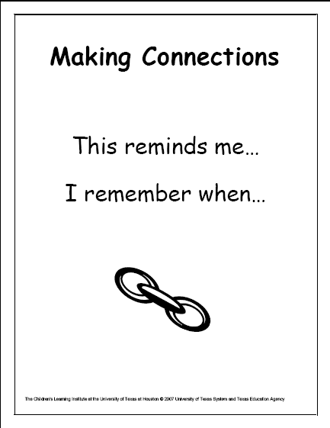

Step 4: Touchstones
Provide students with a hand motion that signals “Making Connections”
Display strategy poster in the classroom
Notes:
Say: When a new strategy is introduced, we provide a kinesthetic hand motion that helps our students remember the strategy, and provides one way they can signal to us that they are using the strategy as they read.
Model hand motion; fingers begin as a peace sign and then come together side-by-side on one hand to indicate they are connected.
Say: I would explain to my students that this hand signal represents two things (fingers) connecting. When I make connections in a think-aloud, I will use the hand signal so my more visual learners will see the strategy in action. My more kinesthetic children may do the signal along with me. All students may use the signals when they make connections in their own reading.
We also display a poster in the classroom that contains key words students will want to use and an icon of a chain link that represents connections. The hand signal, visual icon, and the anchor lesson remind students what the strategy is and why the it is helpful to use while reading.

Slide 41
Step 4: Touchstones
Touchstones: Model hand gesture, explain strategy poster and refer to the anchor lesson.
“See this Making Connections strategy poster? It shows a chain link. The two links are connected. This poster helps us to remember that good readers make connections when they read. Today when I am reading, I will show you when I am making a connection to the text by putting my fingers together to make them connect. Remember, a connection is when something in the text reminds us of something in our background knowledge. For example, we all have background knowledge about dogs. If I was reading about dogs, I could make a connection.”
Notes:
Say: I might explain the touchstones to my students like this.
Read slide.

Slide 42
Step 4: Touchstones
Record what you will say for Step 4 on your orange Cognitive Strategy Lesson Planning Card.
Notes:
Say: Work with others at your table. How will you explain the touchstones to your students?
Read slide.
Provide time for participants to compete Step 4 on their orange Cognitive Strategy Lesson planning card.

Slide 43
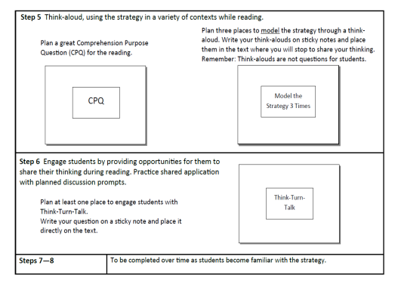
Step 5: Think Aloud (Side 2)
Step 5 is where we SHOW students how we use the strategy while reading.
We plan a comprehension purpose question (CPQ) as well as places to model thinking aloud for students.
Step 5 will differ with each lesson. We transfer the sticky notes from the planning card and place them right on the text.
Notes:
Say: After I have introduced the strategy’s definition and given my students touchstones to aid memory, I think aloud to model how the strategy helps me comprehend while reading. Think-alouds bring invisible thought processes to students’ attention, and increase students’ ability to read strategically (Duffy, et. al, 1987).
Read slide.

Slide 44


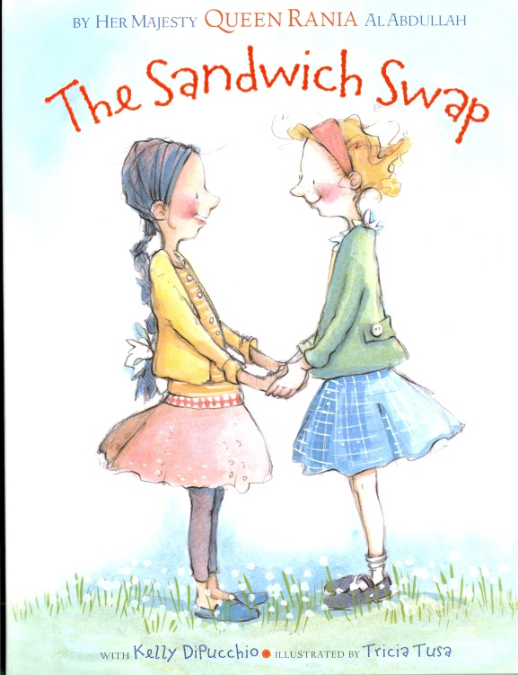

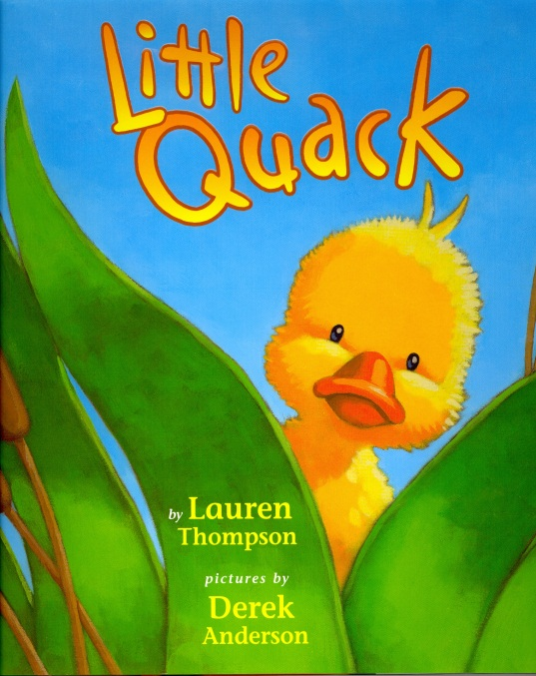
Step 5: Think Aloud
Notes:
Say: Eventually, we will model with a variety of genres and text types. When introducing a new strategy, however, it is important to choose texts which are well-suited to the particular strategy (Duke & Pearson, 2002).
Stories by Kevin Henkes typically make excellent choices for Making Connections. Look for themes that you know students will be able to relate to. For example, at the beginning of the year, you might choose to read stories about coming to school for the first time or about trying something new.
Now, let me take a few minutes to model a short think-aloud for you. I will show you how I would think-aloud making connections in first grade using the familiar book, Owen by Kevin Henkes.

Slide 45
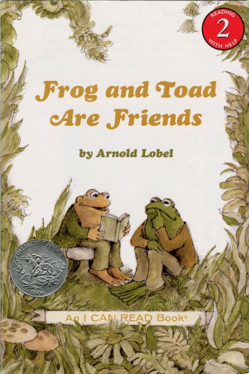
Step 6
Engage students by providing meaningful opportunities for them to share their thinking during the reading. Practice shared application with planned discussion prompts.
p. 25. “Let’s think for a moment Why does Toad feel terrible?” …
Can you make a connection to this? Have you ever hit your head (hand signal)? How did you feel?
Notes:
Say: In Step 6 of the Cognitive Strategy Routine, students and teacher share responsibility for using the strategy. Though we continue to model some of the connections we have, we also ask students to share their connections with the class. We use the Think-Turn-Talk routine as a way to keep all students engaged and accountable for the learning. For example, you may have decided to plan an opportunity for Think-Turn-Talk in the story you just read.
Read the text in red on the slide.

Slide 46
How Can We Help Our Students
Make Connections?
Carefully preview texts and choose texts to which students can relate.
Model authentic connections by thinking through the text yourself before reading with the students.
Be explicit about the ways connections help you understand.
  When modeling, use the stems, “That reminds me of …” and “That helps me understand the text better because …”
  Post these stems for student reference.
Notes:
Say: How can we help our student make connections?
Read first bullet.
Say: As we’ve already mentioned, although in the future we want our students to be able to relate to many different texts, in the beginning texts “… should be chosen to be particularly well-suited to application of the specific strategy being learned” (Duke & Pearson, 2002). For example, we might choose books in which characters have emotions or experiences that students will find familiar. As they become more proficient at the strategy, we broaden the scope of texts to which they apply the strategy, or in other words, we “… move from close to home to more global issues or cultures and places further removed from most children’s lives.” (Harvey & Goudvis, 2007).
Read next two bullets.

Slide 47
Step 6
Can you make a connection to this? Have you ever hit your head? How did you feel?
One time I got hit in the head with a ball. It really hurt and I got all dizzy and I had a bad headache. I felt like throwing up.
Oh dear. You do know how Toad feels! Your connection helps you to understand that Toad has a headache and now he doesn’t feel well.
Notes:
Say: If students aren’t able to tell us how their connections helped them to understand we can reinforce good connections by articulating for students how their connection helped them. Let’s look at this example. The teacher’s talk is in the green speech bubble and the student’s response is in the yellow speech bubble.
Read slide.
Say: As we gradually release responsibility of the strategy to our students, we provide supports, or scaffolds, which will promote application by helping students to bring the strategy to a conscious level. “Learners can temporarily rely on these hints and suggestions until they create their own internal structures” (Scardamalia & Bereiter, 1985 as cited in Rosenshine, Meister and Chpaman, 1996). Once readers have internalized the strategy, they no longer need to rely on these scaffolds.

Slide 48

Step 7: Scaffolded Practice with Support
Scaffold practice, providing opportunities for students to use the strategy while reading with the teacher’s support and monitoring.
Notes:
Say: Step 7 of the Cognitive Strategy Routine, is scaffolded practice with support.
Read the black text on the slide.
Say: In grades K-2, we might choose to model and practice application of the strategy during whole class read-alouds and shared reading. This type of instruction is not sufficient however. I also would be conducting small group reading instruction during part of the reading block, where I would have students in groups of 4-6 reading a book at an appropriate instructional level for the group. During small group instruction, I will encourage students to be aware of the connections they make while reading.
Let’s hear from one teacher about how step 7 works in her classroom.

Slide 49

Step 7: Scaffolded Practice with Support
During small group instruction time, I would listen to one student at a time read a small portion of the assigned text. I would have them share their thinking out loud with me so that I could check on their strategy use and general comprehension. I would ensure that the other students were engaged in the reading until it was their turn for me to listen to them read.
Notes:
Read slide.

Slide 50
Step 8: Accountability
Provide accountability measures for students when using the strategy independently.
“Today when you are reading independently, I want you to think about the connections you make while reading. When the timer goes, I would like you to stop reading and complete a quick-write in your Reading Reflection Journal, telling me about your connections.”
Notes:
Say: In Step 8 of the Cognitive Strategy Routine, we ask students to continue using the strategy in their independent work. We also assess how they use the strategy and whether we will need to return to earlier stages of the routine.
Read the red text on the slide.
Say: Sometimes teachers use a guideline of 80% of the time reading, 20% of independent reading time responding.

Slide 51
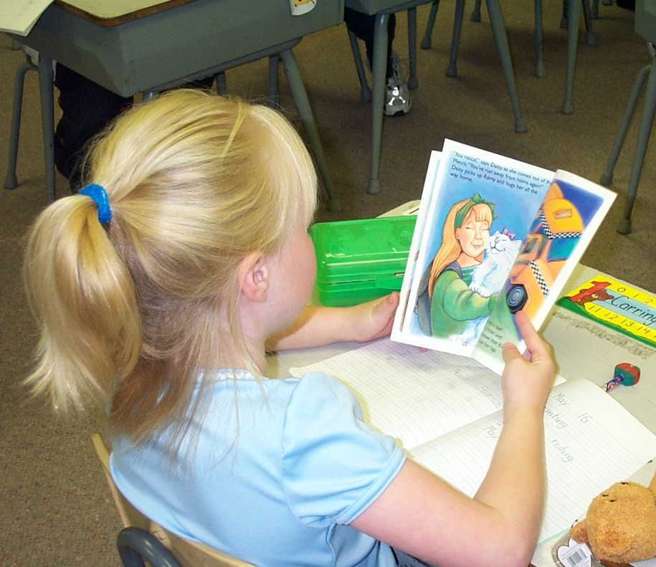
Step 8: Accountability
March 4
This reminds me of my cat and how much I love him. My connection helps me to understand how happy the lady is to find her cat.
Notes:
Say: Here is an example of a quick-write a student wrote in her reading reflection journal.
Read example on the slide.

Slide 52
Making Connections
Other Considerations When Teaching
Notes:
Say: Now that we’ve experienced how we would teach Making Connections following the Cognitive Strategy Routine, let’s think about other aspects of teaching Making Connections that we should be sure to consider.

Slide 53
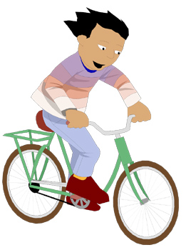


3 Types of Connections
Text-to-Self
Text-to-Text
Text-to-World
Notes:
Say: When teaching Making Connections, we should be aware that there are three types of connections readers make to text.
Read slide.
Say: Let’s take a brief moment to understand these types of connections and how this understanding might impact our instruction.

Slide 54
Tips (Steps 6-8)
  Introduce text-to-text and text-to-world connections when most students are able to make text-to-self connections.
  Allow students to make connections to non-print texts (i.e. movies, video games, television, and music).
  Use graphic organizers to chart relationships between texts.
Notes:
Read slide.

Slide 55
Keep In Mind …
Making Connections is the foundation for many of the other cognitive strategies good readers use. It is important that students have a good understanding of background knowledge, and how they use their background knowledge to make connections during reading.
Notes:
Read slide.
Say: Once students have a strong foundation in Making Connections, we can feel confident in moving on to teaching them to use other strategies in conjunction with Making Connections.

Slide 56
Big Ideas
Activate/build background knowledge
Making Connections = foundational strategy
Beware of distracting connections
Notes:
Say: Let’s review the three Big Ideas we hope you will take away from the training today.
The first Big Idea was “Activate/build background knowledge.” Remember, good readers access their background knowledge when reading. Sometimes we just need to help students activate their background knowledge and sometimes our students may not have sufficient background knowledge about a subject. In which case, we’ll need to help students to build background knowledge.
The second Big Idea was “Making connections=foundational strategy.” Making Connections is really a foundational strategy because a reader often needs to use background knowledge when applying the other strategies.
Finally, the last Big Idea “Beware of distracting connections.” Remember, good readers understand when their connections distract them and take them away from understanding the text. We model for students how to be aware of when this happens and we reinforce that we want them to think about how their connections help them to understand.
We hope that remembering these Big Ideas will help you when you are teaching your students to make connections while listening or reading.

Slide 57
“Background knowledge is a repository of memories, experiences, and facts. When information is read in isolation and not connected to existing knowledge, it is forgotten and deemed unimportant. Calling on existing knowledge and experiences is crucial if readers are to assimilate new information.”
~ Cris Tovani
Notes:
Say: Thank you for attending this session. Please feel free to ask any questions.

