Slide 1
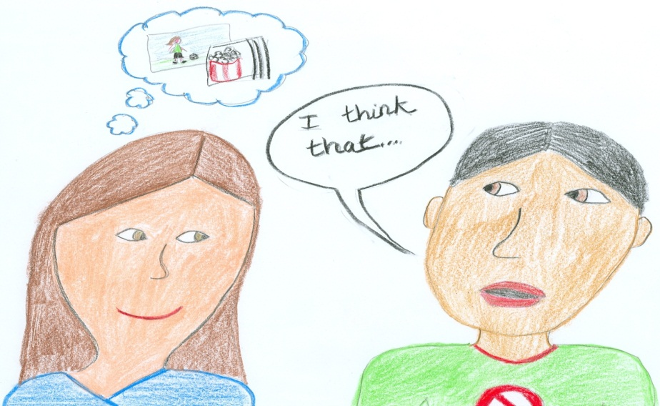
Think-Turn-Talk
Notes:
Introduce yourself and welcome participants.
Say: Let’s begin by reviewing the materials you need for this training.
(Hold items up as you talk.)
Say: You have 2 sets of handouts. You should have 1 set that says Think-Turn-Talk PowerPoint Handout, and one that says Additional Handouts.
We’ve also provided you with a yellow Big Ideas Card that you should have found at your place setting on your table.
Now that we have all of our materials ready, let’s begin our session.
Each participant should have a copy of Frog and Toad and/or Sapo y Sepo. If individual copies are unavailable, provide enough copies for 2 people to share.

Slide 2
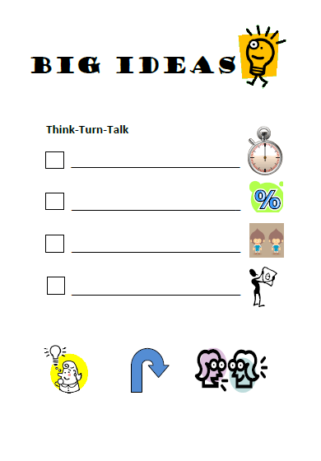
3-5 seconds
time to process
thoughtful pairs
well-planned ?s
Notes:
Say: Please take out your yellow Big Ideas Card. We will use this card today to help us track the important information we should take away from this session. Let’s take a moment to consider the “big ideas” for Think-Turn-Talk.
Think-time should be deliberate and consistent. The minimum think-time teachers should provide is 3 seconds. So, on our big ideas card, on the first line, I would like you to write, “3-5 seconds”.
Click for first bullet to appear.
Say: On the next line, I would like you to write, “55% to 80% of time processing”.
Click for second bullet to appear.
Say: Learners should be provided time to process information in every lesson.
On the third line, I would like you to write, “pair students thoughtfully”.
Click for third bullet to appear.
Say: Be strategic when pairing students. Think about them academically as well as socially. Make adjustments to the partnership as necessary.
Finally, on the last line, I would like you to write, “well-planned questions”.
Click for fourth bullet to appear.
Say: Plan for Think-Turn-Talk stops which will increase the student’s understanding of the lesson.

Slide 3
Session Goals
Reinforce the importance of planned discussions during lessons.
Focus on an instructional routine (Think-Turn-Talk) to increase student engagement through planned discussion.
Experience using Think-Turn-Talk.
Practice and plan to use the Think-Turn-Talk routine.
Notes:
Say: We have three goals during this session:
Read first two bullets.
Say: Think-Turn-Talk is a powerful instructional routine that may also be known as Think-Pair-Share (Lyman, 1981). How many of you have used this routine in your classroom?
Provide time for audience to respond.
Say: You may have used this routine in your classroom as a way to promote student involvement and increase discussion (McTighe & Lyman, 1988), or because you know that “students with learning disabilities prefer to work in pairs” (Vaughn, Hughes, Moody & Elbaum, 2001).
This may not be a new routine to you, but today we are going to address ways to use Think-Turn-Talk more often and more effectively. This cooperative learning routine is equally effective for both young students and adult learners.
First we will talk about why the routine is effective, then we will discuss how to implement the routine as part of your daily instruction, and finally we will practice and plan to use the Think-Turn-Talk routine.

Slide 4
Think-turn-talk?
Why should we use
Notes:
Read Slide.

Slide 5

The Power of Think-Turn-Talk
  Engagement
  Focus
  Think-time
Notes:
Say: There are a number of benefits when we implement the Think-Turn-Talk routine.
Click to reveal bullet: Engagement
Say: Think-Turn-Talk helps all learners to listen and engage in the lesson. Dylan Wiliam (2005) asks, “The big question is: who is doing the thinking in the classroom?” Researchers who have studied exemplary teachers found that the most accomplished teachers were able to promote high levels of student engagement in their lessons and had well-established routines in place(Taylor, Pearson, Clark & Walpole, 1999). We must ensure that all students are thinking and that all students are engaged in our lessons.
Click to reveal bullet: Focus
Say: If we use this strategy every few minutes, learners tend to be able to sit and focus for longer periods of time. Research tells us that “teachers need to keep attentional demands to short bursts of no longer than the age of their learners in minutes. For a 1st grader, that’s about 6 consecutive minutes; for a high-schooler, that’s up to 15 minutes” (Jensen, 1998).
Click to reveal bullet: Think-time
Say: Think-Turn-Talk provides think-time (also referred to as wait-time) for all students, but especially for those who need it. Let’s consider think-time. How long do you predict think-time usually lasts after a teacher asks a question?

Slide 6
Think-time
Positive effects on students:
“The length and correctness of their responses increase.
The number of their ‘I don't know’ and no answer responses decreases.
The number of volunteered, appropriate answers by larger numbers of students greatly increases.
The scores of students on academic achievement tests tend to increase.”
(Stahl, 1994)
3 seconds
1.5 seconds
Notes:
Say: Mary Budd Rowe was the first to investigate wait-time, or what is often referred to as think-time. She defined wait-time as periods of silence that followed teacher questions as well as time following student responses. She found that think-time “rarely lasted more than…
Click to reveal text: 1.5 seconds.
Say: … 1.5 seconds in typical classrooms” (Stahl, 1994). Often, shorter amounts of think-time are provided to students who are perceived as “slow” or “poor” learners (Cotton, 2001).
Click to remove text: 1.5 seconds.
Say: Researchers have discovered, however, that when periods of silence lasted at least…
Click to reveal text: 3 seconds.
Say: … 3 seconds long, many positive effects were observed in both students' and teachers' behaviors and attitudes.
Click to remove text: 3 seconds. Four bullets will appear.
Say: For example, when students are given 3 or more seconds of uninterrupted think-time, there are certain positive outcomes.
Read slide.

Slide 7
Think-time
Positive effects on teachers:
“Their questioning strategies tend to be more varied and flexible.
They decrease the quantity and increase the quality and variety of their questions.
They ask additional questions that require more complex information processing and higher-level thinking on the part of students.”
(Stahl, 1994)
Notes:
Say: Think-time not only provided benefits for students. It also impacted teachers’ behavior.
Read slide.
Say: The threshold of at least 3 seconds is important to receive the benefits of Think-Turn-Talk. One thing to keep in mind however, is that “A number of studies suggest that teachers appear to have difficulty utilizing a wait time of 3 seconds or more” (Tobin, 1987). Even when teachers were asked to wait, they often moved on before 3 seconds had passed. In other words, it’s hard for us to wait, so we must make a conscious effort to do so! Think-Turn-Talk is a routine that can help us make that conscious effort.

Slide 8
The Power of Think-Turn-Talk
Handout #1
  Engagement
  Focus
  Think-time
  Talk-time
  Safer environment
  Application
  Accountability
  Assessment
Notes:
Say: We’ve discussed the benefits of think-time. Let’s explore the further benefits of using the Think-Turn-Talk routine.
Click to reveal bullet: Talk-time.
Say: This instructional routine provides an opportunity to talk for those students who typically answer teacher questions and who process information verbally. In her book, How to Give it so They Get it, Sharon Bowman (2005) states, “If you want them to HEAR it, you talk. If you want them to LEARN it, they talk.”
Talk-time is important for oral-language development. “Children who do not hear a lot of talk and who are not encouraged to talk themselves often have problems learning to read” (Armbruster, Lehr, & Osborn, 2003). Also, research indicates that there are positive effects on attitude and achievement when students engage in increased verbal interaction (Slavin, Johnson & Johnson as cited in McTighe & Lyman, 1988).
Click to reveal bullet: Safer environment.
Say: This routine provides opportunities for quieter students to share their thinking in a safe environment.
Anita Archer (2007) suggests that you may wish to pair more introverted students together so that they are not overwhelmed by more gregarious students. Also, remember that “students with LD prefer to work in pairs (with another student) rather than in large groups or by themselves” (Vaughn, Hughes, Moody & Elbaum, 2001).
Click to reveal bullet: Application.
Say: Think-Turn-Talk allows students to apply learned strategies or skills in context. Brain research tells us that “…the brain learns best when it ‘does’, rather than when it ‘absorbs’ [Pally, 1997]. Thus, all students must think at a high level to solve knotty problems and to transform the ideas and information they encounter” (Tomlinson & Klabfleisch, 1998).
Click to reveal bullet: Accountability.
Say: The Think-Turn-Talk routine also provides built-in accountability. When all students have the expectation that they may be called upon to share their thinking with the whole group, they learn to use the talk-time to clarify their thinking. For example, you may inform students: “I will ask three of you to share your thinking with the whole class after you have had time to talk with your partner.”
When using this routine, it is not necessary for students to raise their hands to answer questions. They should each be prepared to answer when they are randomly called upon.
Debbie Miller (2002) says that, “The time we spend thinking out loud… sets the tone… Children come to understand that I expect a respectful, thoughtful, time-to-listen-and-learn-from-each-other frame of mind.”
Click to reveal bullet: Assessment.
Say: Think-Turn-Talk can be used as an anecdotal assessment tool. When students are sharing with their partners, it is important to listen to their conversations. Many teachers place a list of student names on a clipboard and make note of what they hear at these times. The qualitative data enhance the quantitative data that we collect through formal assessments. This evidence aids us in adapting instruction to meet student needs.
This “listening in” also helps us build relationships with our students. When we use effective questions and take time to ask students, “What makes you think that?” we show them that we are truly interested in what they think (Wiliam, 2005).
Click to reveal box labeled: Handout #1.
Say: Handout #1 in your Additional Handouts summarizes the research behind the key ideas presented on this and previous slides.

Slide 9



Let’s Practice!
Piensa
Voltea
Habla
Notes:
Say: Now that we know why this strategy is so powerful, we’ll examine one way the routine might be used in a classroom.
Because you are adults, I am going to have you select your own partners. With our students we would assign partners.
Take five seconds to find a partner at your table. Show me thumbs up when you have your partner.
Allow participants five seconds to find partners. When all participants have their thumbs up, continue.
Say: Having a structured routine is important to the success of Think-Turn-Talk. We give our students oral and visual cues for all of the steps. I will be sharing one set of signals with you now. You may choose to use different signals on your campus. If you choose your own signals, consistency is crucial. Use the same signals each time you use the routine. You may wish to consider signals that use only one hand. This might be easiest to manage since you may often have a book in the other hand.
When it’s time to think, I’ll say, “Think,” and at the same time, I will touch two fingers to my head and hold them there. (Model hand motion as it is described.)
Say: When it’s time to turn and share your thinking, I’ll say, “Turn and talk with your partner.” At the same time, I will take my fingers from the side of my head, make a turning motion with my hand and will end by touching my fingers to my mouth and then extending my hand forward. Everyone, try that with me. (Model hand motions as they are described.)
Click to reveal three photographs of hand motions. Model each hand motion as the photographs appear and say: Think… Turn… Talk (or Piensa... Voltea… Habla, if modeling in Spanish).
Say: Let’s practice the hand signals one more time together. Think… Turn… Talk. (Model each motion as you talk.)
Say: Now that we know how to get students talking, let’s think about how to get their attention back - how to get them quiet.

Slide 10
Let’s Practice!
Piensa
Voltea
Habla
What is your favorite book?
Why is it your favorite?
Notes:
Say: Ready to practice? Here are the questions I want you to think about:
Click to reveal questions.
Say: What is your favorite book? Why is it your favorite?
I will give you 8 seconds to think about your answer.
Say: Think (or Piensa), and model hand motion.
Icons for “Voltea” (turn) and “Habla” (talk) will automatically appear after eight seconds of think-time. Say each word and model the signal when prompted by the icons on the slide.
Now you have 20 seconds each to turn and talk with your partner about your favorite book.
After 40 seconds say: Five, four, three, two, one. Eyes on me. Thank you for giving me your attention.
Say: Instead of taking this time to share about our favorite books, let’s think about the routine we just experienced.

Slide 11

Think
3-5 seconds
How were you affected by having 8 seconds to consider your answer?
3-5 Seconds
Notes:
Read slide.
Allow 8 seconds of think-time and then ask 2-3 participants to share responses with the whole group. If time allows, you may use numbered popsicle sticks to randomly select those who will share.
Say: Often, responses fall into one of two groups: I liked having time to think about my response or It made me uncomfortable to have to sit quietly because I was already prepared to respond.
Students often fall into one of these two categories as well. Some are eager to respond, raising their hands before the question is even completely asked; others need time to process both the question and the answer. Neither of these response methods is better than the other; we simply process things differently.
Think-Turn-Talk provides benefits for both types of students.
In this example, we gave you eight seconds.
Click to reveal text: 3-5 seconds.
Say: Teachers should deliberately and consistently provide think-time of at least 3-5 seconds after asking a question. Longer think-time may be necessary in particular situations.
Think-time should also be provided after students respond to a question. This allows the student to fully complete a response. It also allows other students to consider what their classmate has said before offering their response.

Slide 12
Think-Turn-Talk
Your Classroom Routine …
Notes:
Say: We’ve just practiced the Think-Turn-Talk routine. How can we make it an effective part of our instruction?

Slide 13
When Can You Use Think-Turn-Talk?
Every lesson!
Every day!
Every content area!
Notes:
Read heading.
Say: We may have used Think-Turn-Talk intuitively or sporadically in the past. We may have done it a few times a week or maybe when we were being observed and had extra time to plan a lesson. We can change the way we think about Think-Turn-Talk, making it both intentional and routine – an approach that we use almost EVERY time we ask a question that engages students in higher-level thinking. In fact, we can use it in…
Click 3 times and read each line.
Say: Most teachers have experienced the following: we ask a question of the class, but find the same few students raise their hands while the rest of the class remain silent. Many students have learned to allow the eager-responders to do the thinking work for them. Remember, the most accomplished teachers have high levels of student engagement and are more likely to ask higher level questions (Taylor, Pearson, Clark & Walpole, 1999). When Think-Turn-Talk becomes a part of the classroom routine, ALL students are given extra opportunities to practice skills and strategies.
In particular, Think-Turn-Talk can help us find additional times during the day to teach reading comprehension strategies. For example, we often struggle to find time to teach and reinforce strategies while reading expository text. If, however, we use Think-Turn-Talk while we read our science text book, we have an opportunity to teach comprehension outside of our reading block. We can also ensure that our students are focusing on the information we’d like them to glean from the science text.
Think for a moment: Could you use Think-Turn-Talk while reading a math problem? During P.E.? At music?

Slide 14

Some Examples:
“Teachers ought to spend 55-80 percent of their time allowing students to process information.”
(Jensen, 1998)
PE: Why is it important for us to play by the rules?
Music: What kind of songs do you like to listen to and why?
Math: Explain how you solved this problem.
Science: Why is it important to recycle?
Social Studies: What are some responsibilities of citizens?
3-5 seconds
time to process
Notes:
Say: Here are some examples of ways we might use Think-Turn-Talk throughout the day:
Read slide.
Click to reveal quotation. Read quotation.
Say: By using Think-Turn-Talk, we can create these processing opportunities throughout the instructional day.
Let’s take a moment to process the information that we have discussed so far. We’ve shared research that validates the power of Think-Turn-Talk, we’ve practiced signals we implement to support the routine, and we know that processing time is crucial to learning in all subject areas.
Pause.
Say: What are you thinking now? How might this information impact your instruction? Think for a moment… (model the hand signal and allow for think-time).
Say: Turn and talk with your partner (model the hand signals as you say turn and talk).

Slide 15
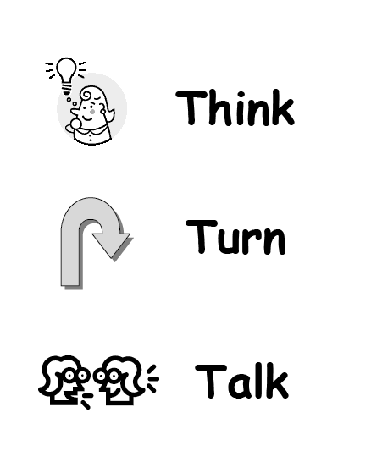
Tips and Tricks
Handout #2
Explicitly teach, model and practice so that expectations are clear
Hang a large version of the poster and refer to it during lessons
Use popsicle sticks or other methods of random selection to choose who will share
http://youtu.be/X02F9DlkPJg
Notes:
Say: If we would like Think-Turn-Talk to become a classroom routine, how do we implement it effectively?
Read first bullet.
Say: You will want to model and practice the strategy several times so that expectations are clear. Without practice, this strategy will not be successful.
Click to reveal the box labeled Handout #2.
Say: Handout #2 provides a lesson plan to teach students the Think-Turn-Talk procedure. We recommend planning an entire lesson devoted to teaching the procedure at the beginning of the year, rather than trying to teach the procedure and give a comprehension lesson at the same time. This lesson plan is a guide. You might decide to use different prompts or signals in your own class. Let’s take a moment to look through this lesson plan together.
Guide participants through the lesson plan stopping to discuss as needed.
Read second bullet.
Say: Particularly in the beginning, the poster can provide your students with a visual reminder of what they should do during Think-Turn-Talk.
You have a separate packet of handouts entitled “Posters.” In this handout you will find 8.5X11” versions of the Think-Turn-Talk posters. These can be enlarged and laminated for your classroom.
Say: You also have shape posters for each word.
Refer to shape posters.
You may wish to use these posters for younger learners. We mount them on colored construction paper to help reinforce what each word means. The red stop sign means stop; it’s time to think /no talking. The yellow triangle means turn to your partner and get ready to talk, and the green circle means that it’s time to talk to your partner.
These shape posters can also be cut out and mounted on popsicle sticks or tongue depressors. We can hold them up individually at each step in the routine.
Read third bullet.
Say: When you would like students to share with the whole class, using a random selection method will help build in accountability for the students. Often, their talk will be more focused if they know that ANYONE could be called on. For example, today we are using popsicle sticks to randomly select those who respond to questions.

Slide 16


Tips and Tricks
3-5 seconds
time to process
thoughtful pairs
Think about how you will pair students
Assign students roles (such as Partner A and Partner B)
Give each partner a specific prompt:
Example: Partner A, tell your partner one thing you learned about penguins after reading this paragraph.
Notes:
Read first bullet.
Say: It is crucial that students are paired strategically. When assigning partners, I want to think about them academically. For example, I do not want to pair my highest student with my lowest student; both of them may become frustrated. I also want to consider my students’ social strengths and weaknesses. You probably would not want to pair two best friends together, or pair a very talkative student with a very quiet student. Even with careful planning, sometimes the partners we assign don’t work out. We must assess the success of the partnerships in our class and adjust as necessary.
Read second bullet.
Say: Assigning roles clarifies expectations for our students; this is particularly important for younger students. The concern is not usually that they will talk at the same time, but rather, that they won’t talk at all.
Students can keep these same roles, A and B, as long as they have a certain talking partner, but the teacher should vary which partner speaks first each time. For example, I might pair my students strategically and have them keep the partner for two to six weeks. Students can remain “A” or “B” for the entire two to six weeks.
Read third bullet.
Say: When I give my students a specific role, my prompts must reflect that. For example:
Read example.
Say: I would then ask Partner B to tell their partner something ELSE they learned about penguins. Next time, I would have Partner B go first.

Slide 17
Think-Turn-Talk
Your Lesson Plans…
Notes:
Say: We have discussed the successful implementation of the Think-Turn-Talk routine. Now we will consider the ways in which we can increase its instructional effectiveness through mindful planning.

Slide 18
Tips and Tricks
3-5 seconds
Plan stops and prompts well in advance.
Where will you stop?
Why will you stop there?
  What is the critical information?
  Is there a part that students will need support in understanding?
  How long have students been sitting and listening?
time to process
thoughtful pairing
well-planned ?s
Notes:
Say: It’s critical that Think-Turn-Talk be planned well in advance. In thinking about a specific text ask: Where will you stop to ask questions? Why will you stop there? What question prompt will you use?
We might look for a spot that has critical information we don’t want our students to miss; we might think about which parts could be confusing to our students; and we think about how long they have had to sit and listen.

Slide 19
Tips and Tricks
Ask questions that involve critical thinking, opinion, or an extended answer.
Specific: “Why does the character …?”
General: “What are you thinking?”
Ask questions that relate to the CPQ
Ask questions that reinforce the cognitive strategy you are focusing on in the lesson
Write prompts on sticky notes and place them in your T.E. as reminders
Notes:
Say: Question prompts are used to engage students in discussion for Think-Turn-Talk. You might just use a generic question such as, “What are you thinking now?” You may also choose to use questions that are more specific to a particular text, such as asking what motivates a character’s actions.
In choosing questions, you may refer back to the Comprehension Purpose Question (CPQ) so that students can reflect on the CPQ and continue to gather information that will help them to answer the CPQ.
When possible, we also try to connect Think-Turn-Talk to the comprehension strategy we are studying.

Slide 20
Tips and Tricks
After a student shares what s/he thinks, ask, “What makes you think that?”
Follow-up student sharing with immediate and corrective feedback.
metacognition
Notes:
Say: Whatever the question we choose, it should be one that allows our students to express their thinking. Questions that have only one correct answer, or where the answers can be found “right there” in the text, do not prove as effective for use with the Think-Turn-Talk routine.
Read first bullet.
Click to reveal text: metacognition.
Say: Researcher Janet Wilde (1998) says, “Teachers can encourage children to make their understanding explicit by talking about it. Research shows that students who talk about how they and others think become better learners.”
Because we have thought carefully about our questions, we do not want to forget them in our actual implementation of the lesson. If we write our Think-Turn-Talk question on a sticky note and place it on the page where we plan to use it, we have a good reminder to ourselves. Because student engagement is so important, we must make sure that we don’t forget our planned discussions.
Show an example of a read-aloud book or a teacher’s edition with a large sticky note for the CPQ and 3-4 smaller sticky notes placed on pages throughout the text.
Say: We also want to follow-up on student responses with immediate and corrective feedback. Let’s take a look at two ways we provide feedback.

Slide 21
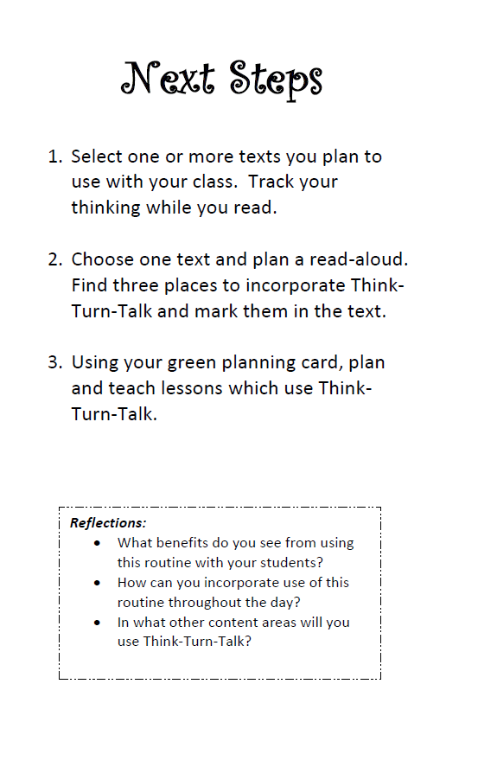
3-5 seconds
time to process
thoughtful pairing
well-planned ?s
Notes:
Say: Let’s revisit the “big ideas” for this session.
First, we want to provide all students with an opportunity to respond to questions. Research has shown that when we allow students at least 3-5 seconds of think-time we see an increase in responses as well as correct responses.
Students need time to process information. This can be accomplished by using the Think-Turn-Talk strategy. Teachers need to spend 55% -80% of their time allowing students to process information.
Be thoughtful in how you pair students. Remember to think about each student’s academic ability as well as their social skills. Don’t be afraid to pair two quiet students.
The last big idea is to plan where you will use TTT. Select 2-3 spots in the text in which the information is critical to the student’s understanding of the story or skill.
As you leave this session today, we want to think about our next steps. We want to take what we have learned here and apply it in our classrooms so that we can truly impact student learning and achievement. Read the 4 steps on the back of this card. Write down at the bottom what your commitment will be for teaching this strategy when you return to school in August.

Slide 22

“Teachers do not create learning. Learners create learning. Teachers create the environment for learning.” (Wiliam, 2005)
Notes:
Click to reveal quotation.
Read quotation.

Slide 23
References
Archer, A. (2007, October). From adoption to expert implementation: Improving your language arts program, grades K-6. Presentation given at Sonoma County Office of Education, Santa Rosa, California.
Armbruster, B., Lehr, M. & Osborn, J. (2003). A child becomes a reader. Portsmouth, NH: RMC Research Corporation.
Bowman, S. (2005). How to give it so they get it: A flight plan for teaching anyone anything and making it stick. Glenbrook, NV: Bowperson Publishing.
Cotton, K. (2001). Classroom Questioning. School improvement research series, Close-up #5. NWREL. Retrieved February 28, 2008, from http://www.nwrel.org/scpd/sirs/3/cu5.html.
Jensen, E. (1998). How Julie’s brain learns. Educational Leadership, 56(3), 41-45.
Lyman, F. (1981). The responsive classroom discussion: The inclusion of all students. In A.
McTighe, J., & Lyman, F. (1988). Cueing thinking in the classroom: The promise of theory-embedded tools. Educational Leadership, 45(7), 18-24.

Slide 24
References
Miller, D. (2002). Reading with meaning: Teaching comprehension in the primary grades. Portland, ME: Stenhouse.
Stahl, R. (1994). Using “Think-Time" and “Wait-Time" Skillfully in the Classroom. ERIC clearinghouse for social studies/social science education ERIC digest. Bloomington, IN.
Retrieved February 28, 2008, from http://www.ericdigests.org/1995-1/think.htm.
Taylor, B., Pearson, P.D., Clark, K., & Walpole, S. (1999). Beating the odds in teaching all children to read. (CIERA Report No. 2-006). University of Michigan School of Education: Center for the Improvement of Early Reading Achievement.
Tobin, K. (1987). The role of wait time in higher cognitive level learning. Review of Educational Research, 57(1), 69-95.
Tomlinson, C., & Kalbfleisch, M. (1998). Teach me, teach my brain: A call for differentiated classrooms. Educational Leadership, 56(3), 52-55.

