Slide 1
A Focus on Comprehension
Brownsville ISD
K-5

Slide 2
A Focus on Comprehension
% Students in District Meeting Target
Notes:
Kinder – 75% students D in Listening Comp on TJL. Don’t have the TPRI data.
G1 – 42% students scoring D in comp on both Story 5 & 6 on TPRI and 49% on Story 1 & 2 of TJL.
G2 – 69% students scoring D in comp on both Story 5 & 6 on TPRI and 60% on Story 1 & 2 of TJL.
G3 – 49% students scoring D in comp on both Story 5 & 6 on TPRI and 60% on Story 1 & 2 of TJL.
G4 and G5 – combined scores of students meeting the target for Understanding / Analysis across Genres, of Literary Texts and Informational texts.

Slide 3
A Focus on Comprehension
Summary of District TLI Goal:
Increase Comprehension of ALL students in grades K-5 by 20% as measured on TPRI, Tejas LEE and STAAR assessments.
Notes:
Read slide.
Say: This is a very lofty goal. For us to make this type of significant change in student achievement, we will need to make a significant change in our instruction. It is clear that what we are doing isn’t working for the students in our classroom. It’s not that there is something wrong with our teaching, instead, we need to think about changing our system so that we can find a way to best meet the needs of the students in our classrooms. One way to accomplish this is to strive for consistency and alignment in our approach to instruction across all age/grade levels and across the district.
Provide an example of how alignment and consistency in instruction is helpful to our students.
Say: This type of alignment and consistency is going to require some change. Researchers of the top performing school systems tell us, “The only way to improve outcomes is to improve instruction”(McKinsey & Company, 2007, p. 29).
Today we will begin this journey of aligning our instruction with a focus on improving comprehension.

Slide 4
A Focus on Comprehension
Instructional Routines | Cognitive Strategies
Reading With Purpose | Making Connections
Think-Turn-Talk | Creating Mental Images
Cognitive Strategy Routine | Making Inferences & Predictions
 | Asking & Answering Questions
Listening Comprehension | Determining Importance & Summarizing
Notes:
Say: Our focus on comprehension will begin with some basic scaffolds for students. Instructional routines. One of the key ways we can support student learning. We have 3 modules which address instructional routines: Reading With Purpose, Think-turn-Talk and Cognitive Strategy Routine. We also have a routine for enhancing the Listening Comprehension of our younger students.
We then have five modules that address the cognitive strategies that researchers have proven to be most effective for supporting student comprehension.
Read slide.
Say: So what are the benefits of implementing the routines and strategies addressed in these modules across the age/grade levles?
Improves the reading achievement of all students
Provides teachers with a framework for instruction to meet the ELAR TEKS & SLAR TEKS
Impacts the quality of instruction while focusing on comprehension
Provides consistent routines in which scaffolded opportunities are embedded to meet the needs of all learners
Influences student achievement in all subject areas
Let’s begin by laying the foundation to strong comprehension instruction by looking at our first module, Reading With Purpose.

Slide 5
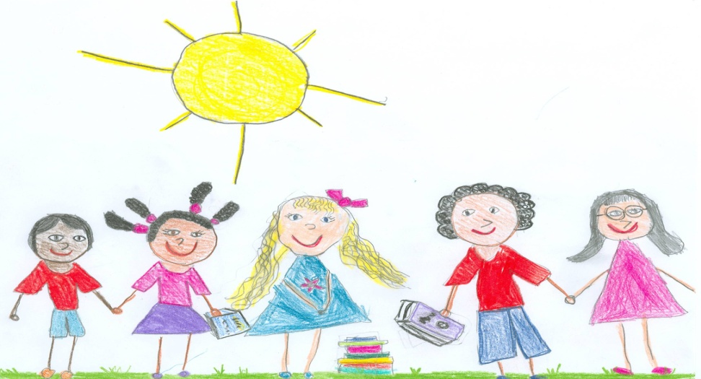
Reading With Purpose
Notes:
Welcome participants.
Let’s begin by reviewing the materials you need for this training.
(Hold items up as you talk.)
Say: You will have two sets of handouts. You should have one set that says Reading With Purpose PowerPoint Presentation, and one that says Additional Handouts. You also have a Going From Good to Great card.
We’ve also provided each of you with a peach colored Big Ideas Card. Let’s take a look at this card now.

Slide 6
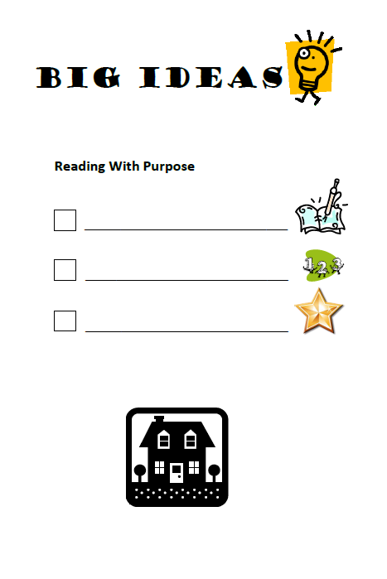
Big Ideas Card
Track your thinking
CPQ for each reading
Good to Great!
Notes:
Say: We will use this card today to help us track the important information we should take away from this session.
On the first line, I would like you to write, “Track your thinking.”
Click for first bullet to appear.
Say: We will see today, the value of tracking our thinking the very first time that we read a text. Thinking about what strategies we use as we read - what we authentically do to comprehend, helps us to know what we need to teach to our students.
On the second line, I would like you to write “CPQ for each reading.”
Click for second bullet to appear.
Say: By the end of this session, you should have a good understanding of what a CPQ is – a Comprehension Purpose Question. This is really what this whole session is about.
On the last line, I would like you to write, “Good to Great!”
Click for third bullet to appear.
Say: As teachers, we ask our students questions all of the time for a variety of reasons. Today, we are going to talk about a special type of question which is used to scaffold students’ comprehension of text. These questions are so special, so important, that we want to ensure that the questions we ask aren’t just good. We want to ensure that our Comprehension Purpose Questions are great! We’ll talk about how we will know if the questions we develop are good or great.

Slide 7
Goals for This Training
Clarify the importance of having a purpose for reading
Explore Comprehension Purpose Questions
Practice a process for setting Comprehension Purpose Questions
Evaluate potential Comprehension Purpose Questions
Select quality Comprehension Purpose Questions
Notes:
Read slide.

Slide 8
Purpose for Reading?
Why should we set a
Notes:
Read slide.

Slide 9
“Comprehension is the reason for reading. If readers can read the words but do not understand what they are reading, they are not really reading.
Good readers are both purposeful and active.”
(CIERA, 2003)
Notes:
Read quote.
Click to highlight the words “purposeful” and “active.”
Say: Guiding students to set a purpose for reading can help them to be both purposeful and active.
Before we discuss how we do this for our students, let’s look at how having a purpose impacts our own reading.

Slide 10
Activity
Handout #1
Read The House silently.
Use a highlighter to highlight the important information as you read.
yellow
Notes:
Say: In your supply box, you will find yellow and a pink highlighters, I would like you to take out both highlighters now please.
You will use your yellow highlighter first.
Open your Additional Handouts packet. Handout #1 is titled The House. In a moment, I will ask you to read The House silently to yourself. This is an independent activity so I shouldn’t hear any talking. While you are reading, I am going to come around and hand out a card to you. Please do NOT look at the card.
I’m going to give you 3 minutes to read The House. While reading, I want you to highlight the important information in the text.
You may begin to read silently.
Hand out the Realtor/Thief cards as participants read. Ensure that each partner receives a different colored card.

Slide 11
Activity
What did you highlight and why?
Share with a partner what you thought was most important in the text.
Notes:
Read slide. Give participants 2 minutes to discuss.
Say: Did you and your partner highlight the same information? Why not?
How did you feel about this assignment?
Encourage participants to share their thoughts. (Example responses: It was difficult; the story had no point; I thought it was going to be about skipping school, but then it didn’t tell anything about that; the story was all detail.)
Say: How would you feel right now if I told you that you were to be tested on the important information in the text?

Slide 12
Activity
Read The House silently again.
If you were the person on the card, what information in the story would be important to you? Using your marker, highlight this information.
pink
Notes:
Say: In a moment, I will ask you to reread The House again.
Each of you has a card placed in front of you. You may now pick this card up and look at it, but be careful not to show anyone around you what the card says. This time while you read, I want you to pretend that you are the person on the card. Using your pink highlighter, highlight the information that is important.
Give participants 2-3 minutes to complete the activity.

Slide 13
Activity
What did you highlight and why?
Share with a partner what you thought was most important in the text this time.
Notes:
Read slide.
Provide time for partners to discuss.
Say: Was it easier to read this time? Did you and your partner highlight the same information?

Slide 14

Why is it Important to Have a
Purpose for Reading?
Think
Turn
Talk
Notes:
Say: I want you to think about this activity (model the hand signal for think). Why is it important to set a purpose for reading? How did having a specific purpose affect your reading? Think …
Turn and talk with your partner about these questions (model the hand signal for turn-talk).
Give participants 2 minutes to complete.
Share responses to the questions. (Example responses: I was more engaged; the purpose for reading was clear; it helped to determine importance; I wasn’t as frustrated.)

Slide 15

Why Should we Set a Purpose for Reading?
Fig. 19 Reading/Comprehension Skills
Students are expected to …
K(A) discuss the purposes for reading and listening to various texts …
1(A) establish purposes for reading selected texts based upon desired out come to enhance comprehension
2(A) establish purposes for reading selected texts based upon content to enhance comprehension
3(A) establish purposes for reading selected texts based upon own or others’ desired outcome …
to enhance comprehension;
Notes:
Say: We can conclude from the previous activity that having a purpose for reading is important. This importance is reflected in our state standards. The key words that we should note here are … purpose for reading … to enhance comprehension.

Slide 16
3 Types of Purpose?
What are the
Notes:
Read slide.

Slide 17
3 Types of “Purpose” to Consider
  Author’s purpose
    What is the author trying to say?
    Why did the author write this piece?
  Reader’s purpose
    Why are you reading this?
    What do you want to find out?
  Instructional purpose
    How will you teach students to comprehend better?
    What cognitive strategy(ies) are you teaching/reinforcing?
    How will you deepen and extend comprehension?
Notes:
Say: As we are planning instruction, there are three types of purpose for us to consider.
Click to reveal bullets. Read “Author’s purpose” and two bullets.
Say: When we think about the author’s purpose, we’re asking ourselves, why did this author write this? Why did the author choose this format or these words?
Click to reveal bullets. Read “Reader’s purpose” and two bullets.
Say: As readers, our purpose might be different from the author’s; that is part of the complex relationship between reader and author. For example, the author of a non-fiction book might write to share knowledge and information, but some people read non-fiction books primarily for entertainment, and secondarily to gain information.
Our students might also have a different purpose for reading than we would like them to have. Often, students’ purpose for reading is simply to finish an assignment. If we would like them to have a more focused or deeper purpose, we will have to provide instruction on the various purposes for reading. As we saw during The House activity, if a reader doesn’t know the purpose for reading, his/her ability to stay engaged and extract important information becomes compromised. This applies to our students just as it does to us.
So as instructors, we need to be sure our purpose is clear to our students.
Click to reveal bullets. Read “Instructional purpose” and three bullets.
Say: We’ll be spending the majority of this session discussing instructional purpose and how to make this type of purpose clearer to our students.

Slide 18
Instructional Purpose
A Focus on
Notes:
Say: When we are directly and explicitly teaching our students skills and strategies to enhance or improve comprehension, then our instructional purpose is just that - improving comprehension. As teachers, we can deepen and extend our students’ understanding of text by setting specific purposes for the reading we do as a class.
When we say, “the reading we do in class,” we are referring not only to the comprehension instruction that occurs during our core reading block, but also to our content-area reading. We are also referring to teacher read-alouds, shared reading, and independent reading.
If we want to increase our students’ understanding of all the texts they read each day, we must plan well and use questions thoughtfully. Today we are going to discuss the planning of a particular type of question. We are going to call these questions comprehension purpose questions, or CPQs.

Slide 19
Instructional Purpose
Instructional purpose includes the use of one guiding question which is set prior to reading.
Comprehension Purpose Question (CPQ)
Notes:
Read slide.

Slide 20
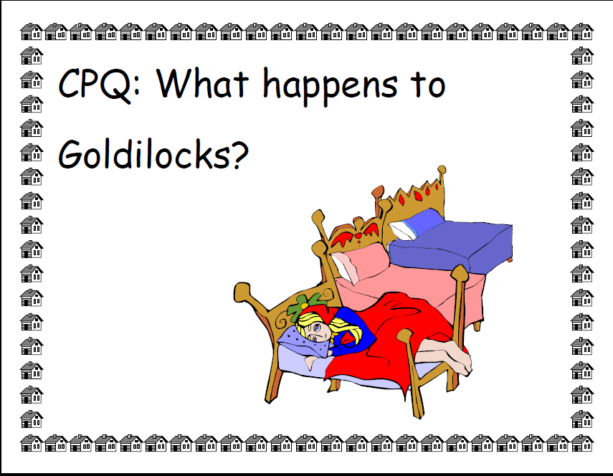
Goldilocks?
Notes:
Say: Simply asking our students multiple questions during text reading, however, may not provide enough support. It can be difficult for even experienced readers to focus on the crucial information in a piece. Therefore, we teach our students to “read with a question in mind” by setting a comprehension purpose question each time we read a text.
A comprehension purpose question, or CPQ, is a question we propose before reading, to guide our students’ thinking as they read. For example, if I’m reading the story “Goldilocks and the Three Bears” I might say to my students, “As we’re reading, I’d like you to think about the question, What happens to Goldilocks in the story?” That would be a very simple question I might pose, the first time I read the story, to help my students gain a basic understanding of the story’s events.

Slide 21
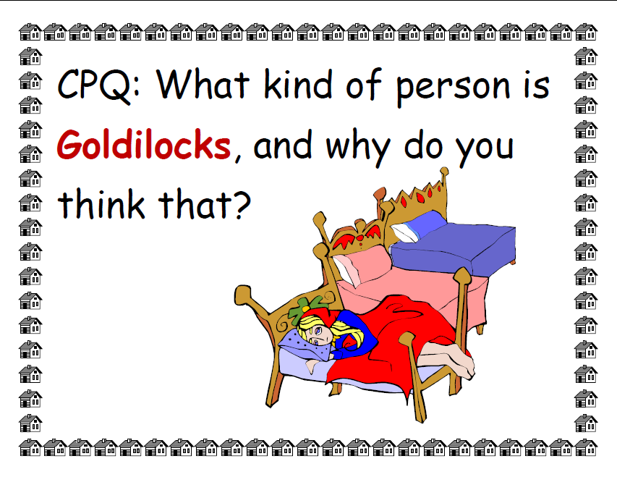
Notes:
Say: Later in the week, I might ask, “As we’re reading, I’d like you to think about this CPQ: What kind of person is Goldilocks and why do you think that?” This question will help my students deepen their understanding because now they have to think about all of Goldilocks’ actions and synthesize what those behaviors indicate to the reader.

Slide 22
Comprehension Purpose Questions
Thoughtful “questions appear to be effective for improving learning from reading because they:
give students a purpose for reading;
focus students’ attention on what they are to learn;
help students to think actively as they read;
encourage students to monitor their comprehension; and
help students to review content and relate what they have learned to what they already know” (CIERA, 2001).
Notes:
Say: Research tells us that this type of thoughtful teacher questioning benefits comprehension in many ways.
Read slide.

Slide 23
Comprehension Purpose Questions?
How do we set
Notes:
Read slide.

Slide 24



It can’t be … that hard … can it?
Notes:
Read slide.

Slide 25

Comprehension Purpose Questions
Handout #2
What is important to remember when setting a CPQ?
Notes:
Say: In just a moment we will read Handout #2 to learn a bit more about CPQs. Before reading, I would like you to notice that I have included a CPQ to help guide your thinking while reading this handout. Your CPQ is: What is important to remember when setting a CPQ?
You may wish to highlight, underline, reread etc., to assist you in identifying the key information needed to answer the CPQ.
When you have finished reading, talk to your partner about how you would answer our CPQ.
Allow time for participants to read and discuss.

Slide 26
Tips and Tricks
  Set a comprehension purpose question for every reading.
  Set a different CPQ each time you read the text.
  Link the CPQ to the strategy you are focusing on.
  Choose a question that will focus attention throughout the reading.
  Post the CPQ for all to see and refer to.
  Check and discuss after reading.
Notes:
Say: As you were reading, you may have identified some of the following ideas:
In planning our CPQs, we think about how many times we’ve read a story. Some texts we will read only once, some we read many times. If it’s the first reading, we’ll set a general question. The story’s title, chapter headings, and subheadings within the text may help us set such a question. Particularly in the first reading, we might ask ourselves “Why does this story have this title?” For example, you could take a heading of an article and change it into a question.
We might have different types of CPQs for narrative and expository text. Often with expository text, we guide our students in grasping the big ideas of a passage. With narrative text, we often focus on making connections, finding out what will happen next, and analyzing characters and settings.
For subsequent readings, we set different CPQs each time we read.
We have only one CPQ for students to focus on at a time. If there is important information that we don’t want students to miss, we might break the text up into chunks and set a CPQ for each part of the text.
We try to link the CPQ to the strategy focus for the lesson. For example, if we’re focusing on making connections, then set a CPQ that will guide students to understand the character or situation better through the connections that they make.
We post the CPQ for all to see. For younger students, we use pictures or colored text to support their understanding.
ALWAYS, we discuss the CPQ at the end of the reading. The purpose for setting CPQs is to guide students’ thinking so that they deepen and extend their understanding, and we must be sure that they are on the right track.

Slide 27
Setting a CPQ
Step 1: Record Thinking While Reading
Step 2: Brainstorm Possible CPQs
Step 3: Integrate With the Teacher Resources if Available
Step 4: Select Great CPQs
Step 5: Select a CPQ for First, Second, or Third Reading
Notes:
Say: Setting good CPQs can be a challenging process. For the rest of this session we will work step-by-step through this process.
Click to emphasize step 1 on the slide.
Say: Step 1 includes recording the authentic thinking we do the first time we read a text..

Slide 28
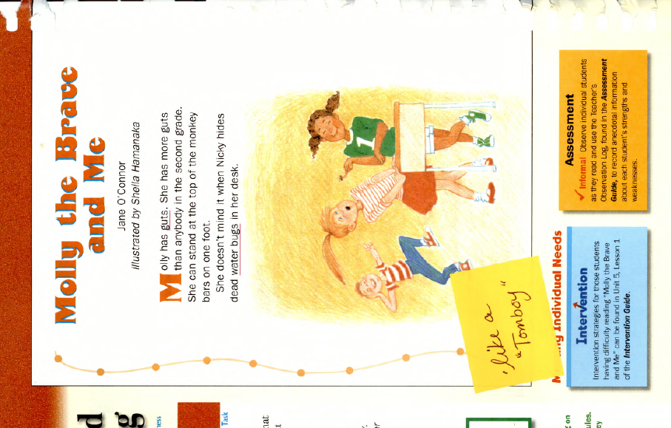
Setting a CPQ With Narrative Text
Handout
#3
Step 1:
Record Thinking While Reading
Open Court Reading
Grade 2, Book 2 (2000)
Notes:
Say: I’m going to model the thinking process one teacher went through in setting the CPQs for three readings of a narrative text, Molly the Brave and Me. In your Additional Handouts packet you may turn to Handout #3. This is the lesson plan for Molly the Brave and Me.
This story is about two friends. One who is brave and one who thinks she is not so brave. The less brave little girl admires the brave girl. Together they go off to the farm for the weekend only to discover in the end that sometimes even the most fearful may be more courageous than they think, especially when a friend is in need.
Say: When reading a book for the very first time, I slow down my thinking on each page. I read a chunk of text - for example, to the bottom of the page - and then stop to think. Whatever comes into my head at the time, I record on a sticky note. This might be a question that I have, a confusion I need to clarify, a connection I am making, or an inference that I figure out. I might make note of important information or something that I want to remember. I track my authentic thinking by recording my thoughts on sticky notes in the text.
This is an example of the thinking done by one teacher while reading Molly the Brave and Me. The sticky notes show the thinking that she had on this page.
Read the story in the folder stopping to model the thinking on the sticky notes at the end of each page of reading.

Slide 29
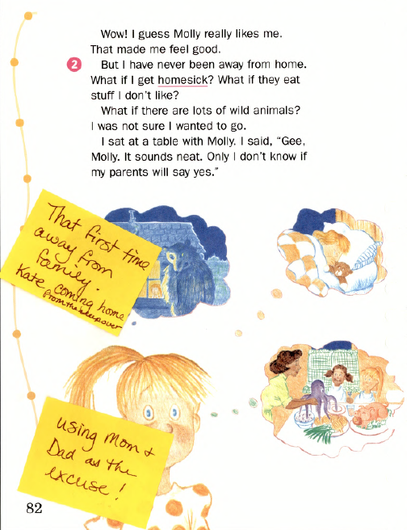
Notes:
Read story and model the thinking on the sticky notes.
Say: You can see from this example how personal and specific the thinking is. You might be able to make similar connections to a child you know who has been afraid to be away from home for the first time, or your connections might be completely different. You might record the inferences that you make such as, “She is using Mom and Dad as an excuse so that she doesn’t have to go.”

Slide 30
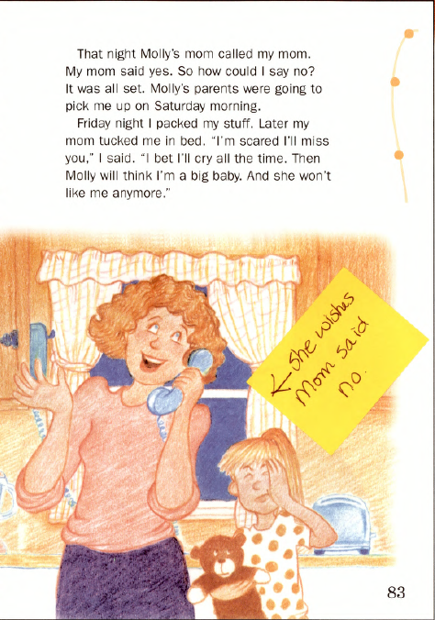
Notes:
Read story and model the thinking on the sticky notes.
Say: Here the teacher recorded more connections that s/he was making while reading the text and looking at the pictures. Pictures are an integral part of the story and we model for students that good readers consider all of the information provided in a text. This information may come from pictures, but also from charts, graphs, photos, etc. Remember, each individual will have different thoughts to record. What you think of while reading will not be exactly the same as what someone else will think.

Slide 31
Setting a CPQ
Step 1: Record Thinking and Brainstorm Questions
Step 2: Brainstorm Possible CPQs
Step 3: Integrate With Teacher Resources if Available
Step 4: Select Great CPQs
Step 5: Select a CPQ for First, Second, or Third Reading
Notes:
Say: Step 2, is where brainstorm possible CPQs.

Slide 32
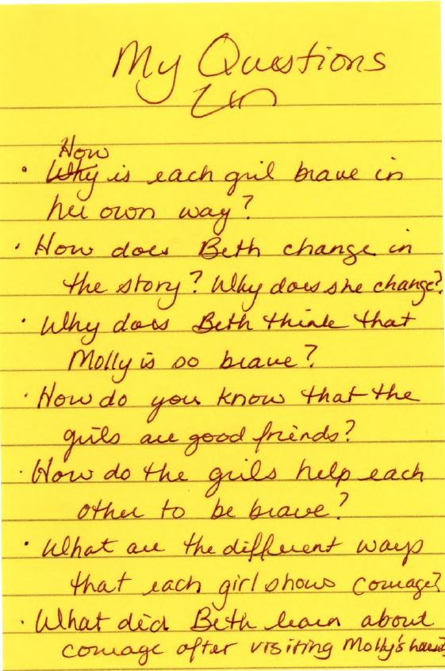
Step 2: Brainstorm Possible CPQs
Notes:
Say: Once I have completed the reading and I have tracked my thinking throughout the text, I take time to reflect on all of the thinking I did. I look for themes that thread throughout my thinking. I also look for places where sharing my thinking for students will benefit their understanding of how I apply cognitive strategies to text. Then I brainstorm possible questions that might focus student attention throughout the reading or help deepen or extend comprehension. I record these questions on a larger sticky note and place them right in my book.
Here is a sample of the brainstorming done by the example teacher.
Read brainstormed list on slide.
Say: Some questions are better than others, and some you might not use with younger children, but these are the questions that the teacher thought of immediately after the reading.
Not all of these questions will be appropriate for the lessons the teacher will want to teach but, at this point, I am not making many judgments about the quality of various questions.

Slide 33
Setting a CPQ
Step 1: Record Thinking and Brainstorm Questions
Step 2: Brainstorm Possible CPQs
Step 3: Integrate With Teacher Resources if Available
Step 4: Select Great CPQs
Step 5: Select a CPQ for First, Second, or Third Reading
Notes:
Say: The next step in planning good CPQs is to consider the instructional ideas presented in the teacher’s edition.
Click to emphasize step 3 on slide.
When I am planning for a read-aloud or content-area reading that does not include a teacher’s edition, I would simply skip step 3 and move on to step 4.

Slide 34
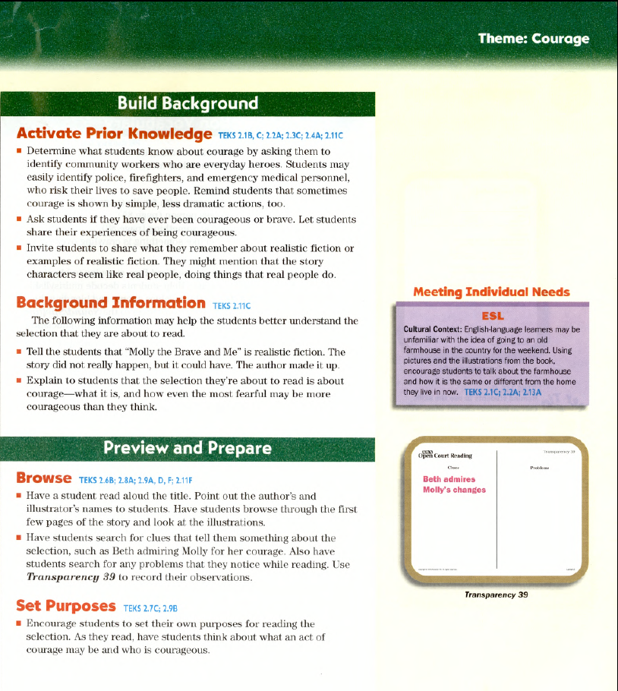
Step 3: Integrate With Teacher Resources if Available
Notes:
Say: Once I have my list of questions, I look in the T.E. to see what kinds of questions are recommended by the program authors. I do not begin with this step because I want to have many possible questions from which to select. If I look at the core program suggestions first, my authentic thinking might be stifled. The T.E. is often full of the same questions that I came up with, and may have better questions than I came up with on my own.
Here’s an example of the thinking I might go through as I look at the T.E.
Click for arrow.
Read Set Purposes.
Say: Encouraging students to set their own purposes is important, but remember if our instructional purpose at this time is to improve comprehension, then we might want to save this point for later in the week or for another time.
Click for arrow.
Read the second bullet in Background Information.
Say: This information might be helpful. We can often take the background information and turn the explanation into a question. This way we can draw attention to the important ideas in the text.

Slide 35
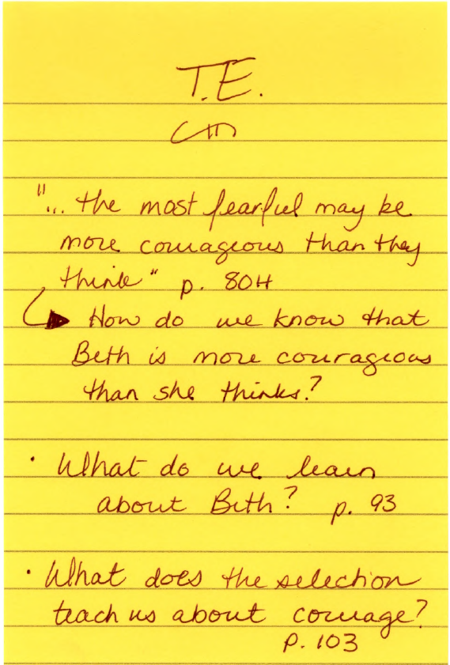
Notes:
Say: After reading the questions in the T.E., I add to my brainstormed list. I don’t have to write down every question suggested by the T.E., only those that I think might make good CPQs.
Here is the list our example teacher has come up with. Listed are the questions s/he brainstormed and the questions from the T.E. that s/he thinks might make good CPQs.
Read questions “From the T.E.” that have been added to the brainstormed list.
Say: Since we don’t have a T.E. for Frog and Toad we will skip this step today, but when you go back to your campuses and begin to plan with your new core program, don’t forget to include this step.

Slide 36
Setting a CPQ
Step 1: Record Thinking While Reading
Step 2: Brainstorm possible CPQs
Step 3: Integrate With Teacher Resources if Available
Step 4: Select Great CPQs
Step 5: Select a CPQ for First, Second, or Third Reading
Notes:
Say: We now have an extensive list of questions. How do we select the questions to use in a specific lesson?
Click to emphasize step 4 on the slide.
In step 4, we will focus on selecting great CPQs for our lessons.

Slide 37
CPQs : Going From Good to Great!
A good CPQ:
A great CPQ:
Is answered in the text either directly or indirectly
Involves some student thinking
Will focus on comprehension
Relates to student learning
Cannot be completely answered until students have read the entire text
Involves higher order thinking, inferences, and text evidence
Will deepen and extend comprehension
Relates to the comprehension strategy currently being taught
Notes:
Click for first bullet.
Say: A good CPQ is answered through reading the text. Sometimes we might think of a question that is not answered in the text, either directly or indirectly. That would not be a good CPQ. For example: if I am reading Goldilocks, “Why do the bears like porridge?” would not be a good CPQ because it is not answered in the text.
Click for second bullet.
Say: A great CPQ, however, is not answered until students have read the entire text. If a question can be answered on the first or second page, we would choose a different CPQ.
Click for third bullet.
Say: Good CPQs will lead our students to think, not just pick out details from the text.
Click for fourth bullet.
Say: A great CPQ will lead our students to use higher order thinking. They may have to make inferences, combining text evidence with their background knowledge.
Click for fifth bullet.
Say: Good CPQs help our students focus on meaning and the important information in a text.
Click for sixth bullet.
Say: Great CPQs will lead our students to understand more deeply each time they read a text. While my first CPQ might address the story as a whole, with each reading I ask my students to dig deeper and be more thoughtful in their reading.
Click for seventh bullet.
Say: A good CPQ will not just deepen understanding, but will help our students make links to information they’ve learned previously.
Click for final bullet.
Say: A great CPQ will link to a comprehension strategy or skill I’m currently teaching. For example, if I’m teaching my students to analyze characters, I might use the question, “How would you describe Goldilocks and why?” because it links to that skill.
We have provided you with a Good to Great card that you may wish to keep close by as you plan CPQs.

Slide 38
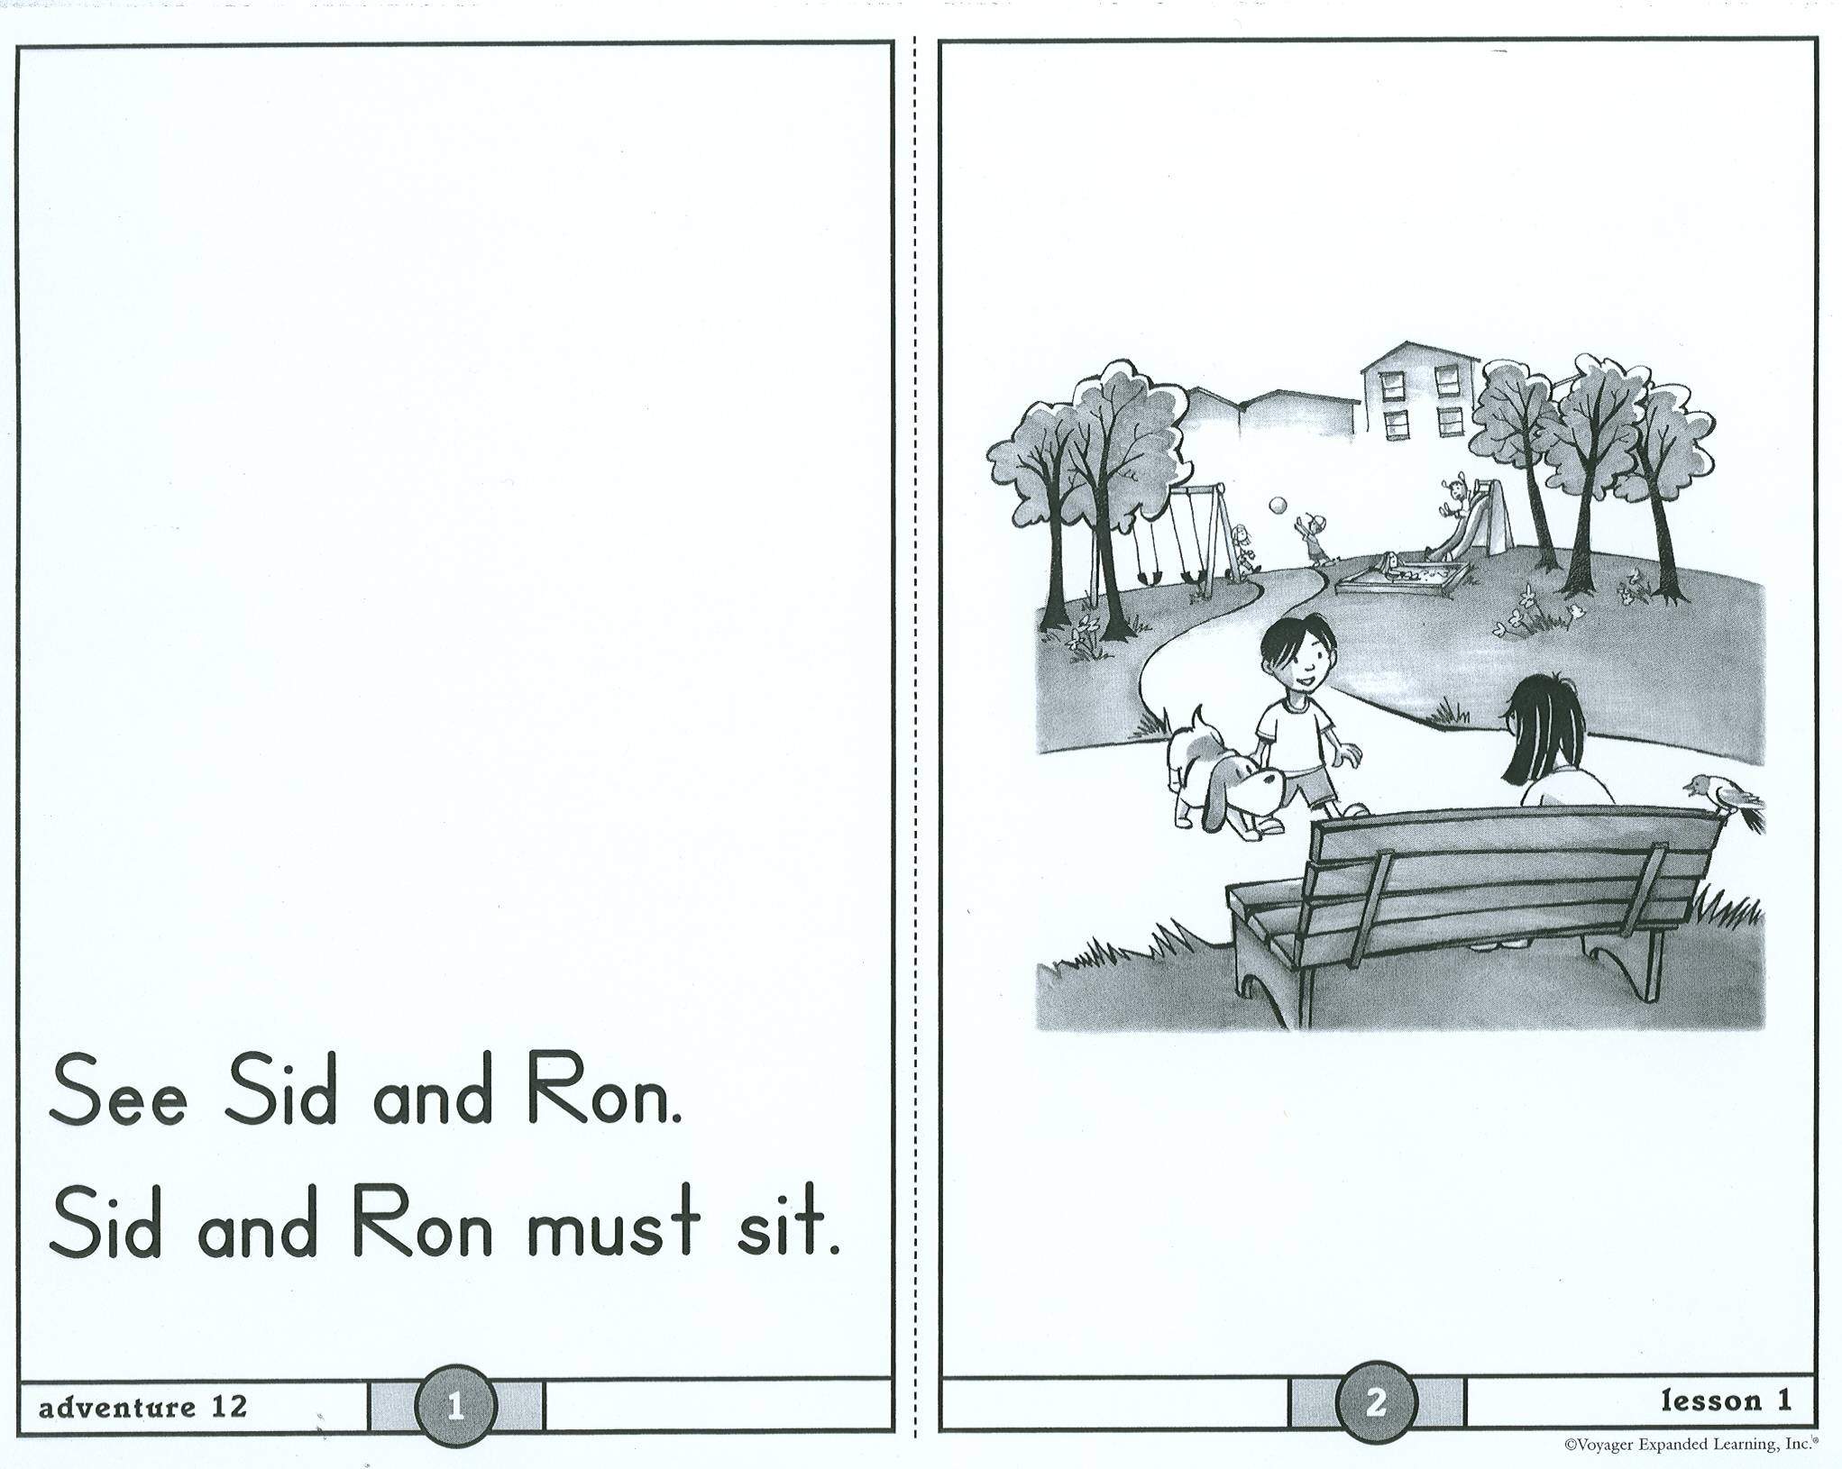
Why must Sid and Ron sit?
What do the characters have to do?
What do the children have to do?
What do Sid and Ron have to do?
Notes:
See Speaker Notes RWP Add 1.

Slide 39
Setting a CPQ
Step 1: Record Thinking While Reading
Step 2: Brainstorm Possible CPQs
Step 3: Integrate With Teacher Resources if Available
Step 4: Select Great CPQs
Step 5: Select a CPQ for First, Second, or Third Reading
Notes:
Say: Now we can feel confident that we can select great CPQs to aid our instruction. How do we select which one to use for first, second, or third reading?
Click to emphasize step 5 on the slide.
Say: If we are only reading a text once, of course, we will skip this step.

Slide 40
First Reading? Second Reading? Third Reading?
First reading: Focus on the story as a whole. (Ex: What do we learn about Beth and Molly?)
Second reading: Deepen understanding.
(Ex: What are the different ways that each girl shows courage?)
Third reading and beyond: Deepen and extend understanding. (Ex: What does the story teach us about courage and friendship?)
Notes:
Click. Read first bullet.
Say: The first time we read a text, we would like our students to focus on the meaning in its entirety. We might ask our students fairly general questions, perhaps focusing on the events of a story or what we learn about the characters. Our example (“What do we learn about Beth and Molly?) is such a question. We learn many different things about each girl throughout the story.
Click. Read second bullet.
Say: For our second reading, we will ask a slightly deeper question. For example, asking, “What are the different ways that each girl show courage?” allows our students to think about the characters in relation to the problem in the story and it also prompts students to begin thinking about the theme of the story.
Click. Read third bullet.
Say: For third readings and beyond, we ask students questions that deepen understanding even more. Our third question, “What does the story teach us about courage and friendship?” This question encourages students to think deeply about the theme of the story and the message the author is really trying to convey to the reader. This is truly a deeper understanding.
Sequencing our CPQs is not an exact science. After delivering a lesson, we might realize that our second CPQ would have made a wonderful first CPQ, or we might realize that a CPQ didn’t focus our students the way we would have hoped. It is important that we make note of this so that, when our colleagues use the same text or we repeat the lesson the next school year, we can strengthen our CPQs.

Slide 41
CPQ With expository text
Setting a
Notes:
Say: We have spent the majority of time talking about setting CPQs with narrative text. Let’s spend a few moments now, discussing setting CPQs with expository text.

Slide 42
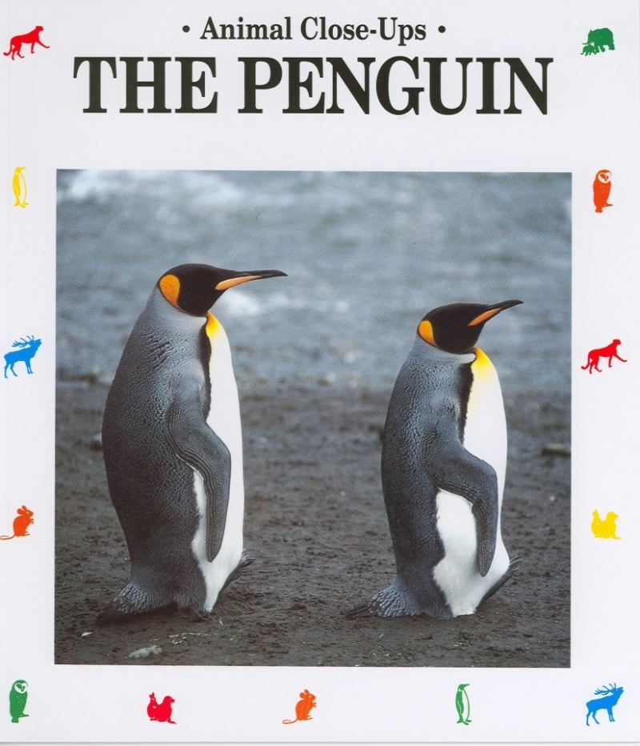
Setting a CPQ With Expository Text
Notes:
Say: Setting a CPQ with expository text can add an extra layer of challenge to this process.
We must think carefully about the information we’d like our students to extract from the text. Thinking this through in advance, will guide us in setting a great CPQ.
I’m going to model the thinking process one teacher went through in setting the CPQs for an expository text for Voyager, Animal Close Ups: The Penguin. I added one step to my process. Once I had some possible CPQs, I returned to the text to highlight information that answers my CPQ. This will help me to know whether this was truly the information I wanted my students to focus on.

Slide 43
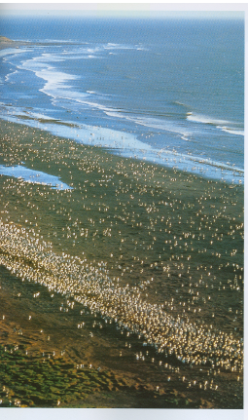

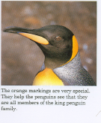
Why is
The penguin,
a funny bird
?
At the bottom of the world lies a string of small rocky islands in the Antarctic ocean. Millions of king penguins live there. They cannot fly. These birds stand in the wind and rain chattering so loudly that their noise can be heard from far away.
Notes:
Say: Often when planning with expository text, we can turn headings into a CPQ. For example, let’s look at this heading, “The penguin, a funny bird.” Who can turn this heading into a question?
Take an answer from the audience. Click to add CPQ to slide.
Say: Right. Why is the penguin a funny bird? Using that question to help focus our thinking, let’s read and see what we find out.
Read the text. Stop after each sentence to check with the CPQ. Does the information read answer the CPQ? If not, then read on. If it does, click for yellow highlights to come up. Highlights indicate the information that answers the CPQ.
The following words will be highlighted:
Millions
Cannot fly
Stand in the wind and rain chattering
Heard from far away
Say: This heading makes a good CPQ.
By going through this process, we can determine how the CPQ will focus our students’ attention on particular information.
Sometimes, however, the decisions we must make are more complicated.

Slide 44
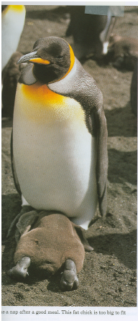

Why / how do
The chicks change
their feathers
What do you learn about penguin chicks?
What happens to the chick after it hatches?
?
In January, the chicks hatch – knock, knock, knock. The sound of the chick trying to break through the shell goes on for two days. After it is out of the shell, the chick stays warm under its parents. A fine gray blanket of feathers begins to grow on its naked body. In three weeks, it has a thick, warm, chocolate-brown coat.
The chicks have no waterproof feathers so they cannot go fishing for food. They have to wait for their parents who go back and forth from their baby to the ocean bringing fish to feed their babies. The parents hold the fish in their throats so the baby has to reach into the parent’s mouth to get the fish.
Notes:
See Speaker Notes RWP Add 2.

Slide 45
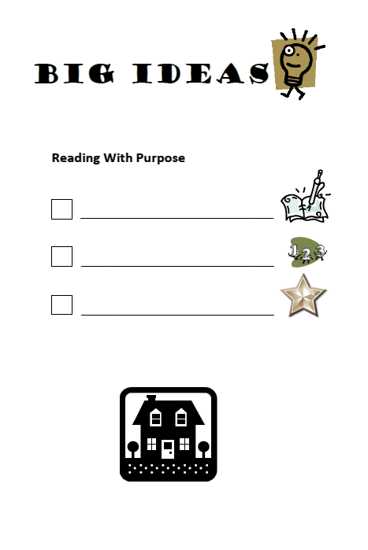
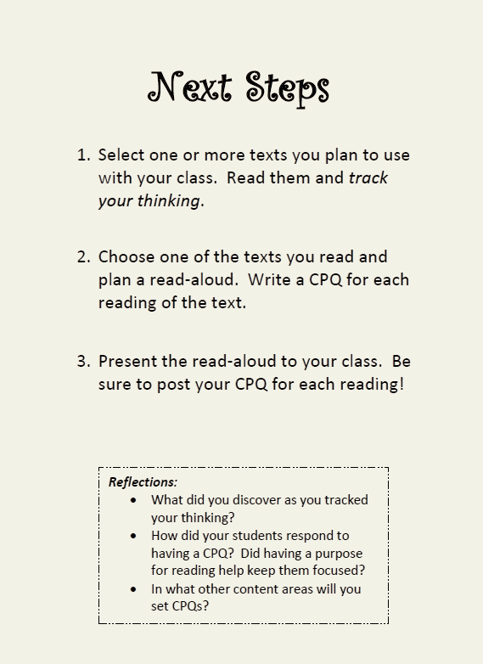
Track your thinking
CPQ for each reading
Good to Great!
Notes:
Say: Let’s revisit the “Big Ideas” we wanted you to leave this session with.
We should now see the value of tracking our authentic thinking the first time that we read a text.
We know that we set a different CPQ for each reading, and we strive to maximize our instruction by ensuring the question we pose prior to reading is worthwhile – that it is a great question.
As you leave this session today, we want to think about next steps. We want to take what we have learned here today and apply it in our classrooms so that we can truly impact student learning and achievement. Read the 3 steps on the back of this card and consider the questions in the reflection section when thinking about what you will do when you return to your classroom.

Slide 46

“The purpose of reading is always understanding.”
~ Harvey & Goudivs, 2007
Notes:
Say: Are there any questions?

Slide 47
References
Beck, I. L., & McKeown, M. G. (2006). Improving comprehension with questioning the author: A fresh and expanded view of a powerful approach. New York: Scholastic, Inc.
Center for the Improvement of Early Reading Achievement (CIERA). (2001). Put reading first: The research building blocks for teaching children to read. National Institute for Literacy.
Fontanel, B. (1992). The penguin: Animal close-ups. Watertown, MA: Charlesbridge Publishing.
Harvey, S. & Goudvis, A. (2007). Strategies that work: Teaching comprehension to enhance understanding. Portland, ME: Stenhouse Publishers.
O’Connor, J. (1990). Molly the brave and me. In Open Court Reading, (2000). Grade 2, Book 2. WrightGroup/McGraw-Hill.
Pichert, J. & Anderson, R. (1977). Taking different perspectives on story. Journal of Educational Psychology, 69, pp. 309-315. In C. Tovani, I read it but I don’t get it: Comprehension strategies for adolescent readers. (2000). Portland, ME: Stenhouse Publishers.
Scott, A. (1996). Brave as a mountain lion. In Open Court Reading, (2000). Grade 2, Book 2. WrightGroup/McGraw-Hill.

Slide 48
References
Scott, A. (1996). Brave as a mountain lion. In Scott Foresman Lectura, (2000). Grado 3, Unidad 3. Upper Saddle River, NJ: Pearson Education.
Vaughn Gross Center for Reading and Language Arts. (2007). Features of effective instruction. University of Texas System/Texas Education Agency.
Voyager Universal Literacy System. Treehouse, daily reading selections, student book K. Unit 4, Seasons all around.

